Slide 1
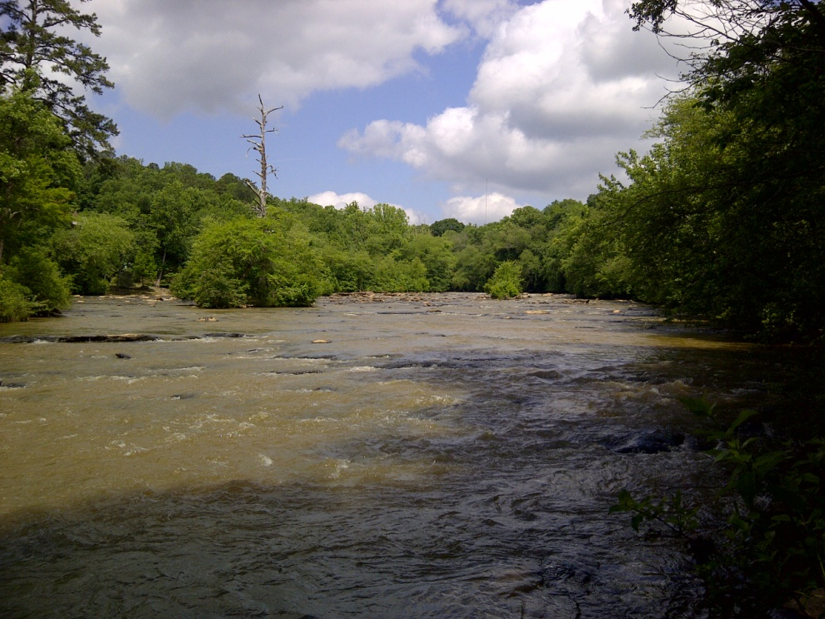
Using Models to Explore Options for Middle Oconee River Management
Kyle McKay, Ph.D., P.E.
U.S. Army Corps of Engineers
kyle.mckay@usace.army.mil
601-415-7160
Notes:
Abstract:
River managers are constantly faced with challenging trade-offs between multiple uses of Georgia’s water resources such as providing municipal water supply, supporting recreational kayaking, and maintaining ecosystem integrity. The Middle Oconee River in Athens is no exception, and how communities withdraw municipal water supply can affect a variety of outcomes ranging from the resilience of a community’s water supply to the ability of the river to provide habitat for native fish. Numerical models are being developed to assess the potential consequences of alternative river management strategies in the Middle Oconee River. These models help managers explore many water withdrawal options and inform them of the effects of those decisions.

Slide 2
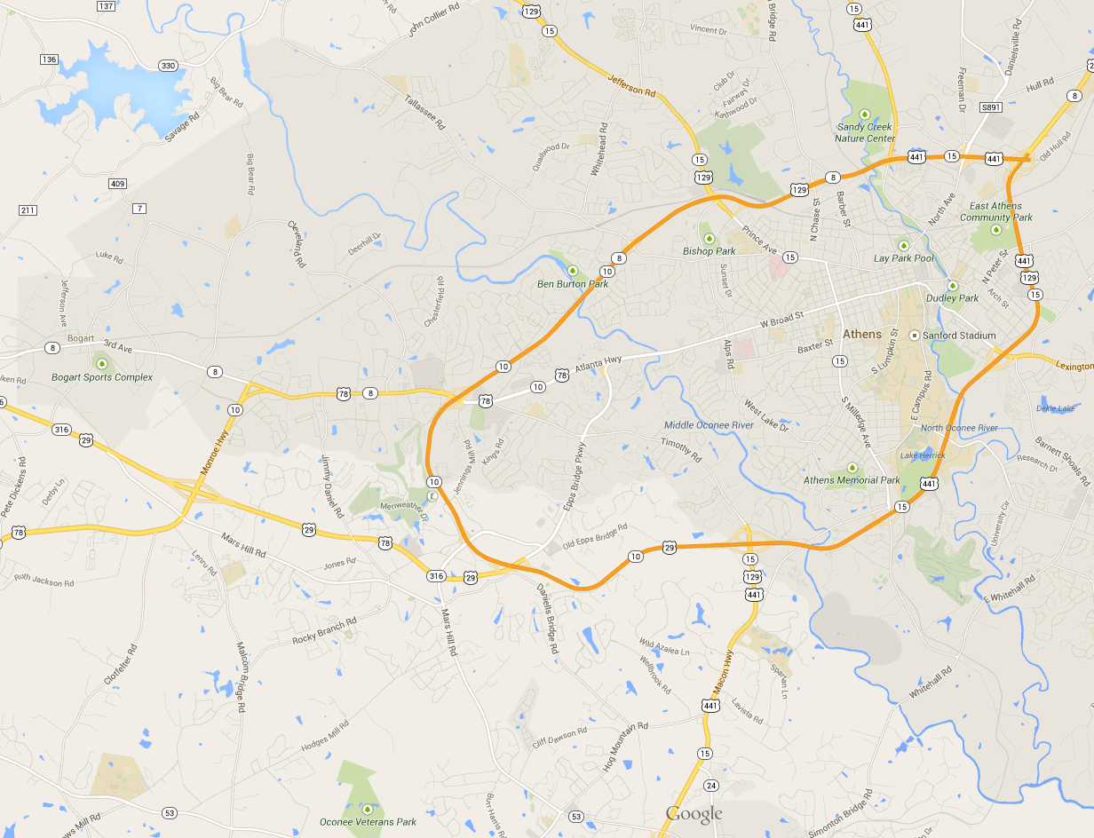
3
1
2
Bear Creek Reservoir (#3)
Constructed in 2002
Permitted to withdraw 60 million gallons per day (MGD)
Currently withdraws < 20 MGD
Notes:
Here at the University of Georgia, when the toilet flushes, the water came from one of three places. The primary source is near downtown on the North Oconee River. When this river is low, the city uses a secondary supply from the Middle Oconee River at Ben Burton park.
In 2002, ACC joined with three neighboring counties to buy a water insurance policy, Bear Creek Reservoir. This off-channel reservoir pumps water from the Middle Oconee River and stores it in Jackson County. This provides Athens with a third water supply, and makes our community much more resilient to drought.
Because Bear Creek is a secondary water source for these four counties, there is more flexibility in how withdrawals can be made. For instance, a larger portion of pumping could occur during wet winter months when withdrawals represent a much smaller fraction of available river flows. This project focuses on the ecological and water supply effects of different withdrawal regimes to Bear Creek Reservoir.

Slide 3
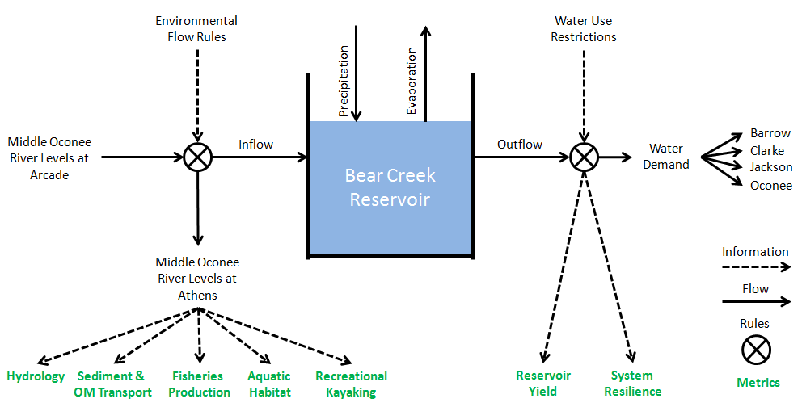
Can we meet municipal water demand with less environmental impact?
Supply-Side Levers
Demand-Side Levers
“Lines of Evidence”
Notes:
The overarching question driving our study is, “Can we meet municipal water demand with less environmental impact?”
Here, a simple model of Bear Creek Reservoir is shown, which depicts the key inflows, outflows, and storage of water in the system. On the supply-side, upstream water levels and environmental flow regulations determine reservoir inflows. On the demand-side, reservoir outflows are governed by water use in the four counties along with drought restrictions.
Using these models, many ecological and social outcomes can be assessed. Each “line of evidence” tells a new chapter in the story of local river management. The models also allow us to test alternative management schemes related to both pumping decisions and demand management.

Slide 4
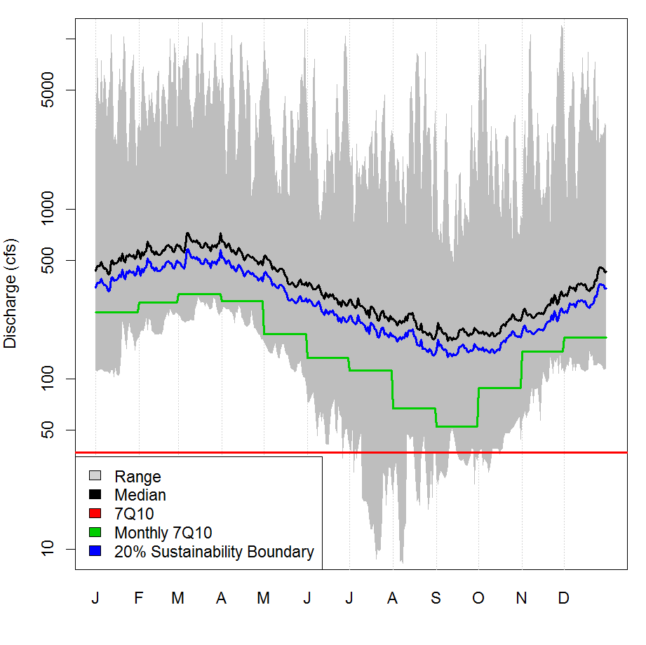
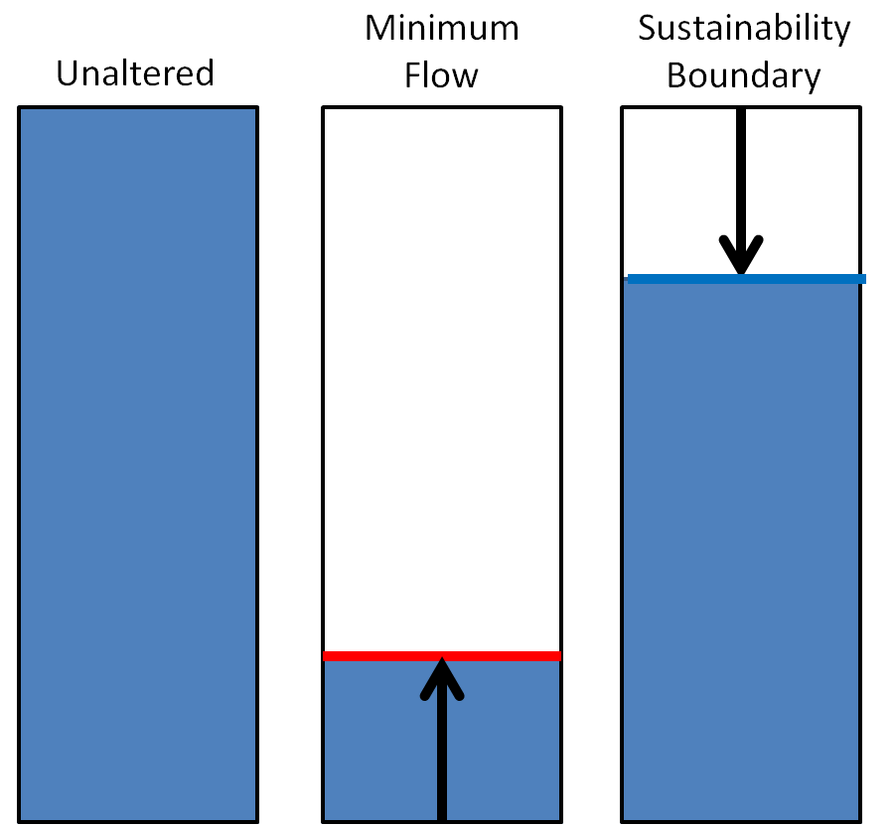
Options for river management
Minimum Flows
Annual 7Q10
  Old State Regulation
Monthly 7Q10
  New State Regulation
Sustainability Boundaries
% difference from observed discharge

Slide 5
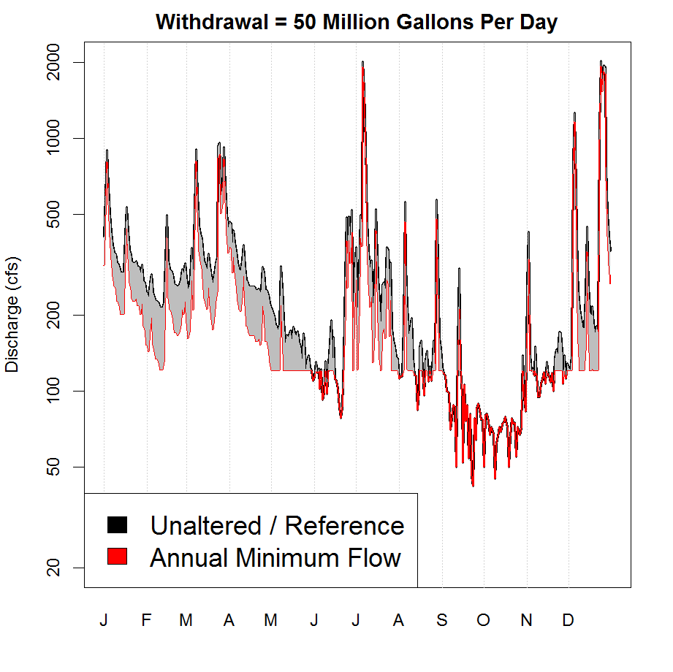
Simulating Water Withdrawal to Test Management Actions
60 year historical record (1938-1997)
Modify historical flow based on competing options
How much water can we withdraw?

Slide 6
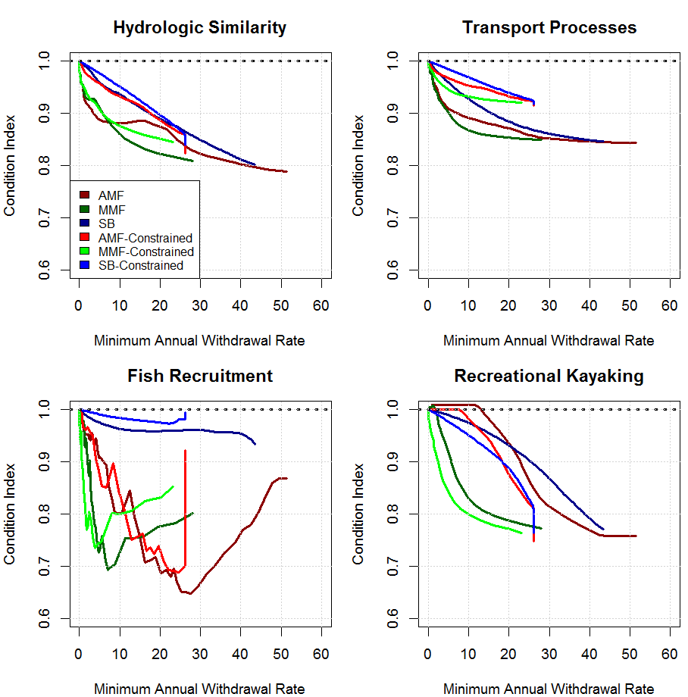
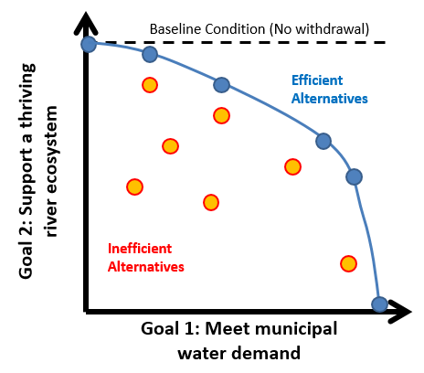
Understanding Trade-offs Associated with Different Management Actions

Slide 7

Parting Thoughts
Model simulations can be powerful tools to understand the effects of decisions.
Managers can “play games” to test scenarios of interest.
Modeling does not require operational changes, but can inform experimental operations (and test our hypotheses about the river).
Many thanks to Alan Covich, Mary Freeman, Rhett Jackson, John Schramski, and the UGA River Basin Center!
Kyle McKay, Ph.D., P.E.
kyle.mckay@usace.army.mil
601-415-7160
Notes:
Mention non-river management examples: urban flooding, land development, etc.

