Slide 1
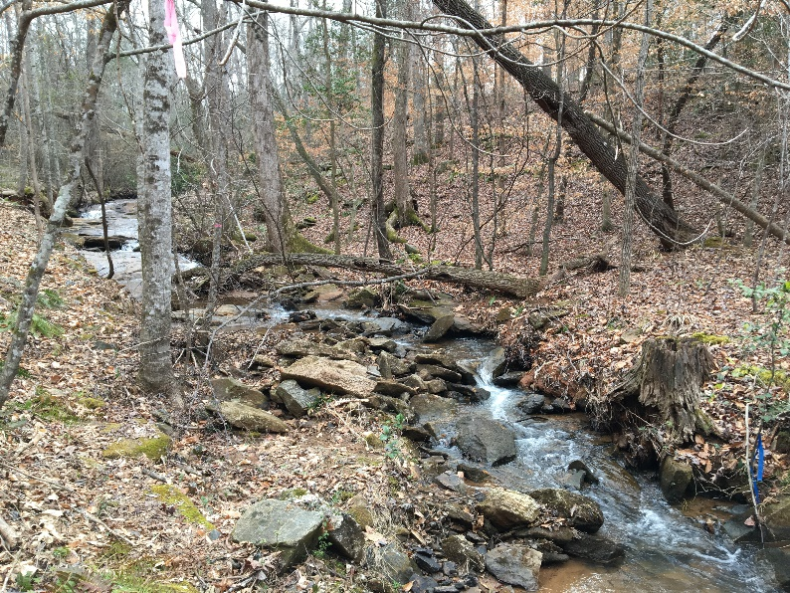
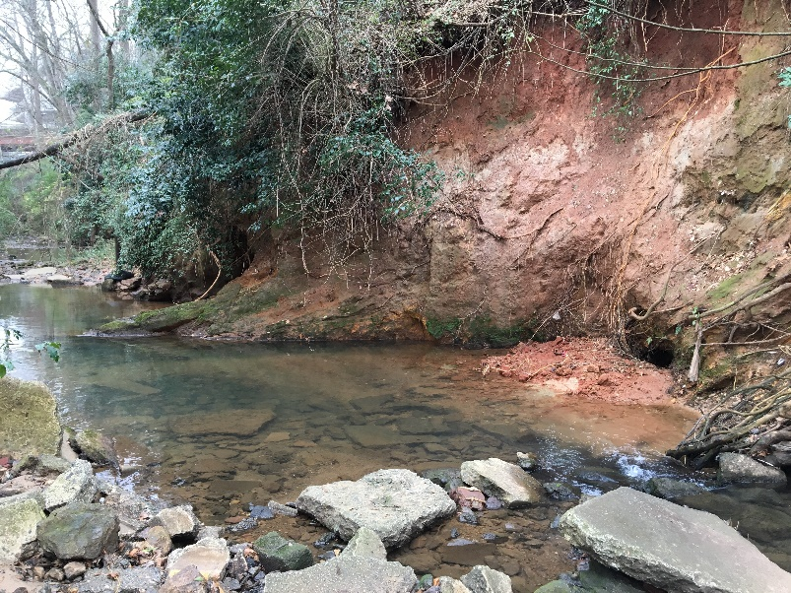
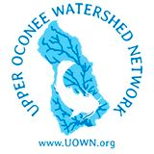
Long-term trends in the Upper Oconee Watershed using UOWN’s citizen-science data
Phillip Bumpers¹, David Manning¹, Reid Brown¹, Amy Rosemond², Bruno Giri¹
¹The Upper Oconee Watershed Network
²Odum School of Ecology, University of Georgia
Notes:
My name is Phillip Bumpers, I am a research coordinator here in Ecology, but today I am filling my role as board member of the Upper Oconee Watershed Network, where I am the current science and monitoring chair

Slide 2
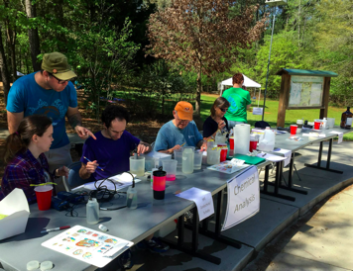
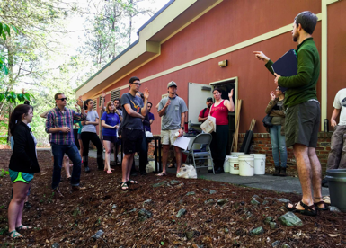
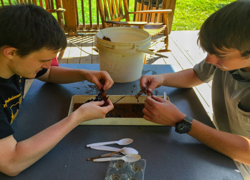
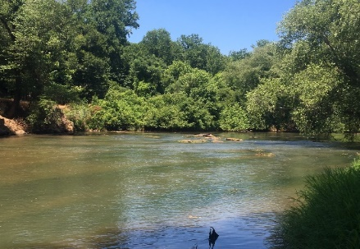
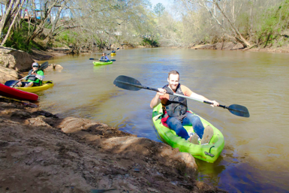
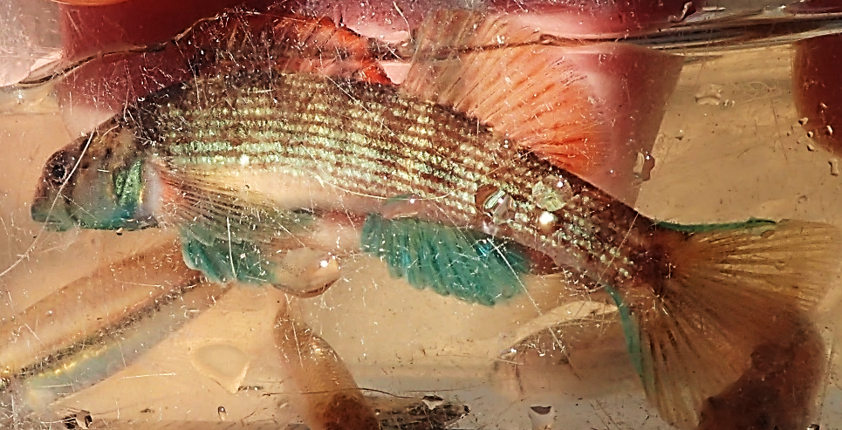
Thanks to the thousands of volunteers…
That make it possible to monitor the health of our streams and rivers to:
Promote ecosystem services provided by streams and rivers
  Drinking water, pollution removal, etc.
  Athens gets water from the North and Middle Oconee for drinking water
Promote safe and enjoyable recreational opportunities
Promote healthy ecosystems and biodiversity
Notes:
The upper Oconee watershed network or UOWN is a 501c3 non-profit created with the mission of protecting our water via community-based advocacy, monitoring education, and recreation. The first RR event, which I believe you all are attending in a week and a half was held in 1998 and 2 years later in 2000 UOWN was officially created. We are an all volunteer organization, including all board members and committee members ,and our data collection is completely supported by citizens and many student volunteers!

Slide 3
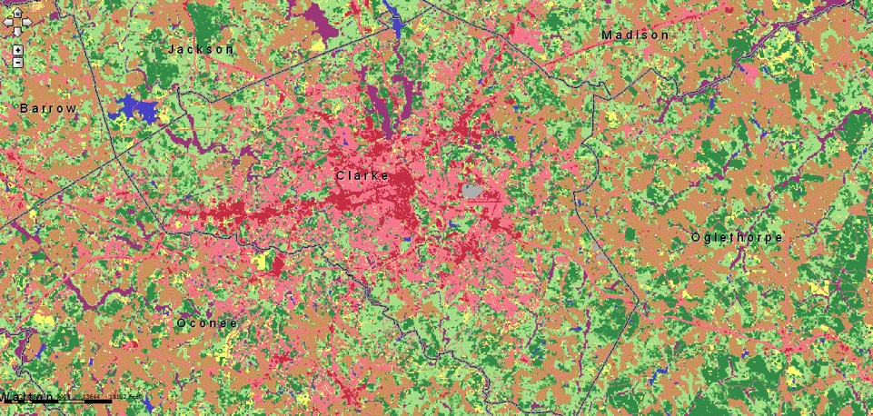
Athens-Clarke County is a growing urban center
Urban land cover
Forest
Pasture/Agri

Slide 4
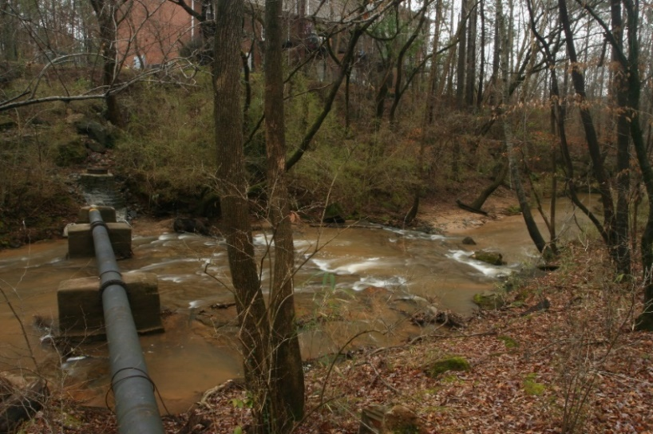
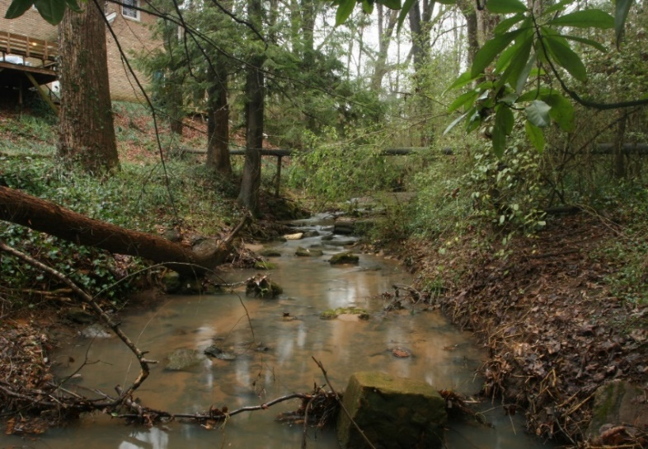
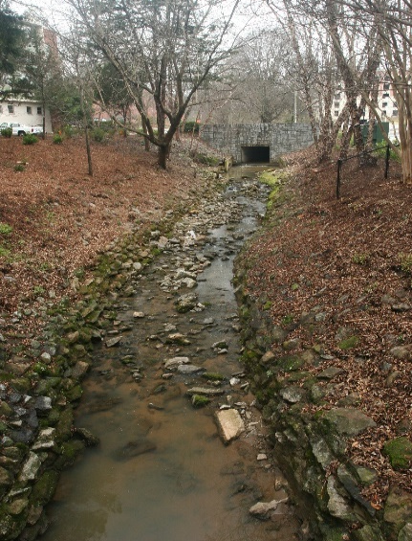
Impacts of urbanization are quite evident
Hunnicutt Creek
Tanyard Creek
Brooklyn Creek
Notes:
So why a watershed group in Athens? Well, streams are super interesting and they provide us with great recreational opportunities and ecosystem services such as clean drinking water. Athens has 2 major rivers-the North and Middle Oconee-that provide us drinking water, and we have a lot of smaller streams that are tributaries of the two big rivers. We are lucky to have so many streams in our area to enjoy, but unfortunately, some of our stream are in better condition than others. And UOWN was founded with the purpose for citizens to monitor the health of their watershed, and do what we can to keep it a little healthier than it would be otherwise for Athens residents and those downstream of us in the Oconee and Altamaha Rivers. Athens is a growing urban center, which means our streams are increasingly vulnerable.

Slide 5
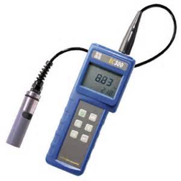
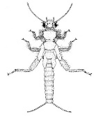
UOWN collecting data since 2001
Quarterly sampling of:
Fecal coliform/E. coli
Specific conductivity (good measure of general pollution)
pH
Turbidity (water clarity)
Total Nitrate/Phosphate
Habitat visual surveys
Macroinvertebrates-biotic index (following Adopt-a-Stream)
Sensitive
Somewhat-Sensitive
Tolerant
Notes:
UOWN has been collecting data since 2001, which means we now have some pretty good time series of data to begin looking for real trends in the health of our streams. We hold quarterly sampling events each year and volunteers go out and collect water samples from as many streams as we can that day and we analyze the samples for specific conductivity, which is a measure of electrical conductance basd on the concentration of ions in the water and is a good measure of general pollution, we also collect pH, turbidity, total nitrate and phosphate, and a subset of streams we collect samples for E coli and then another subset we collect macroinvertebrates from and calculate biotic indices based on the compostion of the invertebrates present

Slide 6
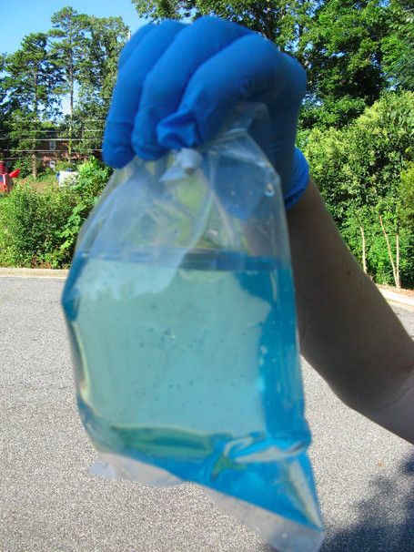
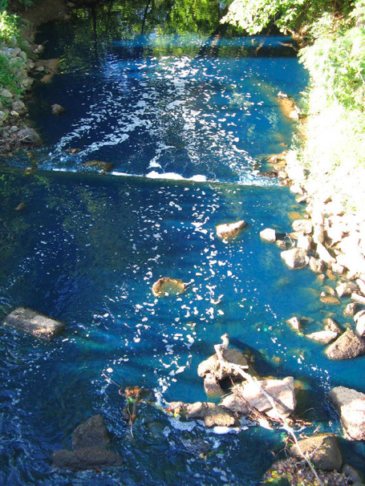
What is done with the monitoring data?
Values above red are cause for human health concern
1) Detect acute pollution/disturbance events (e.g. sewer leaks), and potentially determine the effects
2)Evaluate long-term trends in stream heath in response to development and land use practices
An acute pollution event happened in Trail Creek in July 2010
Notes:
July 28 2010 – we had our own headline making spill. Chemical storage facility caught fire, efforts to put out the fire resulted in flushing of chemicals into nearby headwaters of trail creek. Turned the creek bright blue. Chemicals may have included known carcinogens, methanol, formadahyde, dichorlobenzene others?

Slide 7
Chemical spill negatively impacted Trail Cr
UOWN sampling was able to capture the effect of the spill on Trail Creek.
Data suggest that stream has recovered to pre spill conditions
Though still in decline over time
Biotic integrity
Manning et al. 2015, GWRC
Notes:
UOWN data was able to capture the effect of the spill and because we had long-term data on other streams we were able to show this was not created by annual variation. Trail creek is in fiar condition and may be declining. Bear creek is one of our better reference streams and Carr creek is our worst stream due to a fertilizer plant, a rock quarry upstream and other pollutants associated with urban areas. A glimmer of hope is that it may be slightly improviing.

Slide 8
North Oconee streams in worse condition
5 MIDO streams
3 NORO streams
Good
Biotic integrity
Fair
Poor

Slide 9
Long-term trends in ACC streams
Blue = Middle Oconee tribs
Yellow= North Oconee Tribs
Green=Oconee Tribs
Notes:
Bear creek is one of our better streams that we have long-term data on, and had not changed since we have been collecting data. But many of our streams are declining like Trail creek and tthers like Orange Trail, which is still in good condition, but has declined a lot-likely due to high nutrient concentrations. Carr creek, whish is well known as Athens worst stream for multiple pollution sources, may be slightly improving.

Slide 10
Long-term trends in ACC streams
Good to Excellent
Fair
Take home:
Two of the three “reference streams” show negative trends,
Streams with positive trends have a long way to go
Poor
Good to Excellent
Fair
Poor
Good to Excellent
Fair
Poor
Notes:
Bear creek is one of our better streams that we have long-term data on, and had not changed since we have been collecting data. But many of our streams are declining like Trail creek and tthers like Orange Trail, which is still in good condition, but has declined a lot-likely due to high nutrient concentrations. Carr creek, whish is well known as Athens worst stream for multiple pollution sources, may be slightly improving.

Slide 11
Long-term trends in ACC streams
Specific conductance a cheap and effective way to triage potential for impairment
Long-term trends indicate that as conductivity goes up, biotic integrity goes down
Biotic integrity
Notes:
Bear creek is one of our better streams that we have long-term data on, and had not changed since we have been collecting data. But many of our streams are declining like Trail creek and tthers like Orange Trail, which is still in good condition, but has declined a lot-likely due to high nutrient concentrations. Carr creek, whish is well known as Athens worst stream for multiple pollution sources, may be slightly improving.

Slide 12
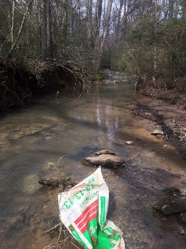
Summary
Citizen-science data can be an effective way to capture the effects of acute and chronic disturbances
Long-term data is critical to assess trajectory of stream health
Chemical pollution is a major contributor to reduced stream health
ACC streams are in need of TLC
Continued monitoring is a must as ACC continues to grow
Notes:
Bear creek is one of our better streams that we have long-term data on, and had not changed since we have been collecting data. But many of our streams are declining like Trail creek and tthers like Orange Trail, which is still in good condition, but has declined a lot-likely due to high nutrient concentrations. Carr creek, whish is well known as Athens worst stream for multiple pollution sources, may be slightly improving.

Slide 13
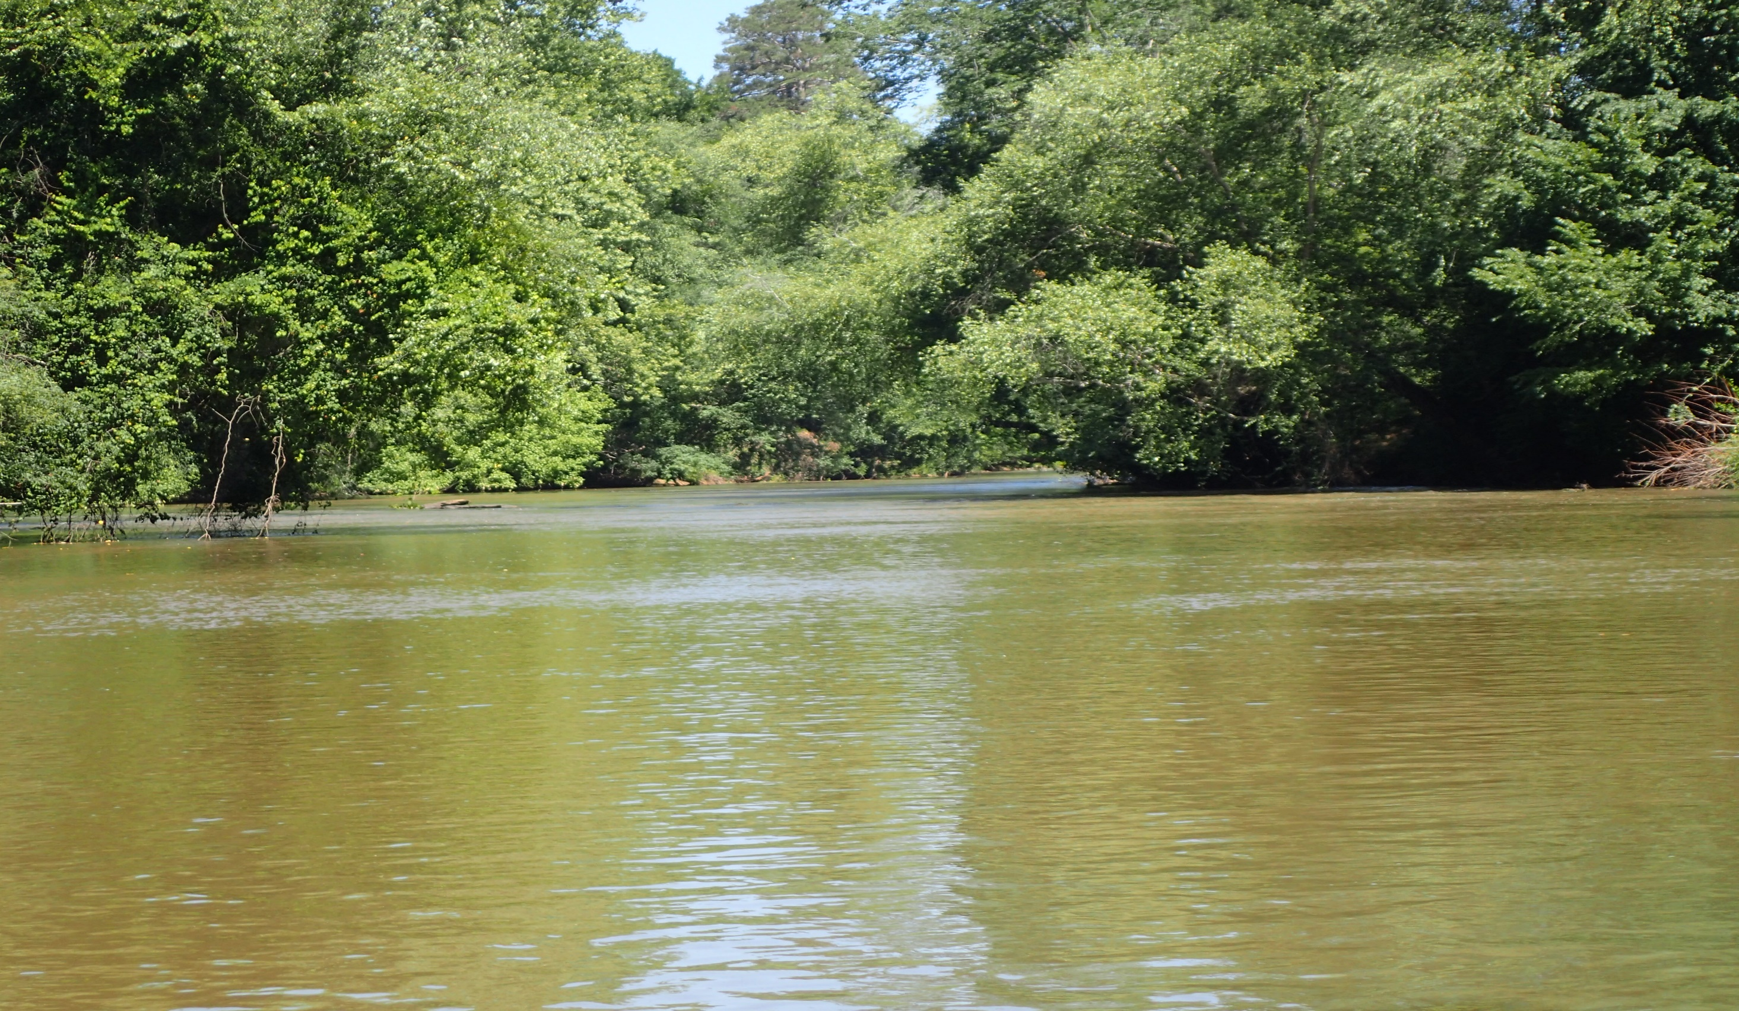
Connect with UOWN:
uown.org
Twitter: @UpperOconee
Like us on Facebook! to stay up to date
Upcoming quarterly sampling: Sunday November 6th at Sandy Creek Nature Center
Notes:
Before I really get started I’d first like to give a plug for UOWN. Our website is UOWN.org, where we post event info and all of our data is publicly available through this site. Some of you here may have even used it for class projects. I also encourage you to follow us on twitter if you are into the twitter world-we mostly use it for event updates, but also advocacy and education. And of course, like us on facebook for the best avenue of keeping up with events.

