Slide 1
Connecting conductivity and macroinvertebrate response to inform watershed management
Emily M. Johnson, Phillip M. Bumpers, Seth J. Wenger, Amy D. Rosemond, John K. Spencer
Odum School of Ecology, University of Georgia, Athens, GA 30606

Slide 2
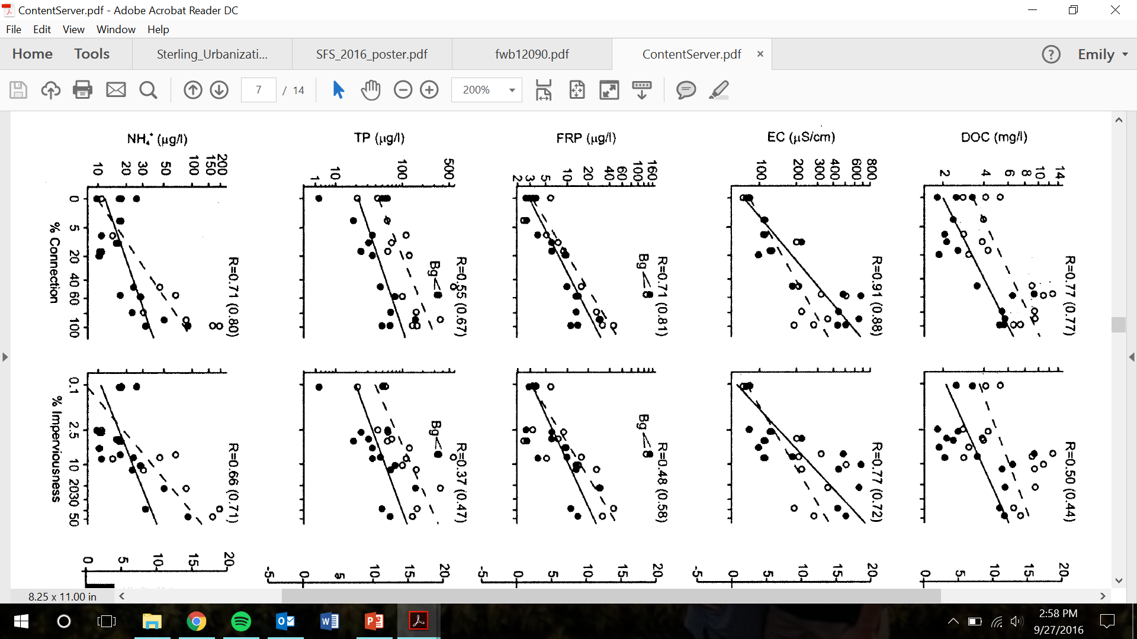
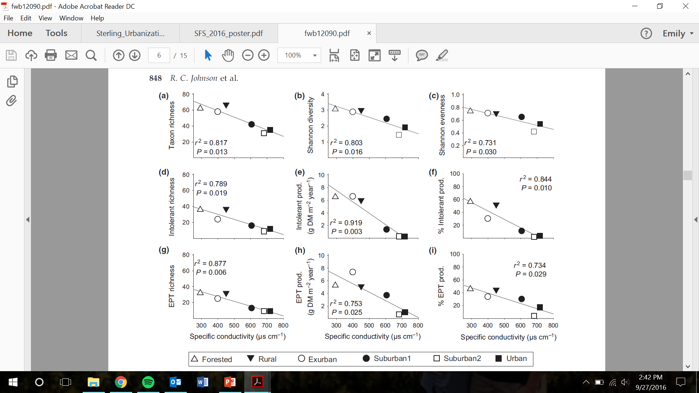
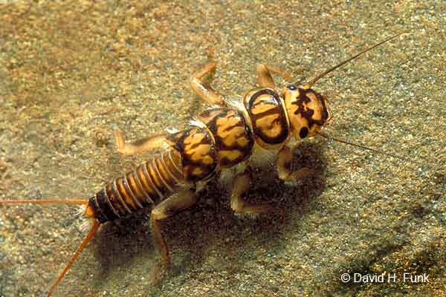
Conductivity, Biota, and Stream health
Conductivity (uS/cm)
# of Species
Conductivity (uS/cm)
From Hett et al., 2004
From Johnson et al., 2003

Slide 3
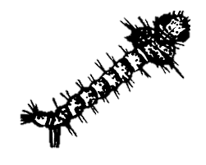


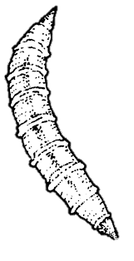
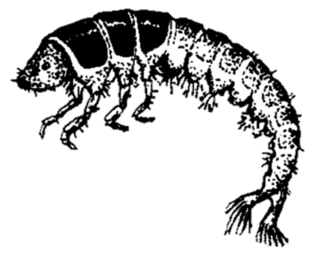

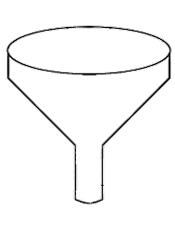

Macroinvertebrates
Critical link in stream food webs
  Break down leaves, wood, etc.
  Prey for larger predators
Indicators of pollution
  Sensitive taxa
Conductivity affects physiology
Conductivity
??

Slide 4
Conductivity- Predictive Tool for Stream Health
What is (electrical) conductivity?
  The ability of a medium to conduct an electrical current (uS/cm)
  Measure of the total amount of dissolved ions in water
  Specific Conductance (SPC) = conductivity at 25˚C
Sources
  Natural (underlying geology) vs. anthropogenic (human activity)
Drivers
  Conductivity driven primarily by hardness (Mg, Ca)
  Also NO₃ and Na

Slide 5
Conductivity and Land-Use in Athens-Clarke County
Brickyard Creek
Diagnostic of stream impacts
  Runoff inputs
  Sewer leakage
  Sediment inputs
Currently difficult to detect
Brooklyn Creek
SPC
stage height
Tallassee Creek
Notes:
**SLOW DOWN**
Conductivity per se may not be responsible for biotic impairment, but conductivity is correlated with numerous potential stressors (e.g., Sterling et al. 2016).
•Alternatively, occasional spikes in conductivity (unobserved in baseflowsampling) may be an acute rather than chronic stressor.

Slide 6
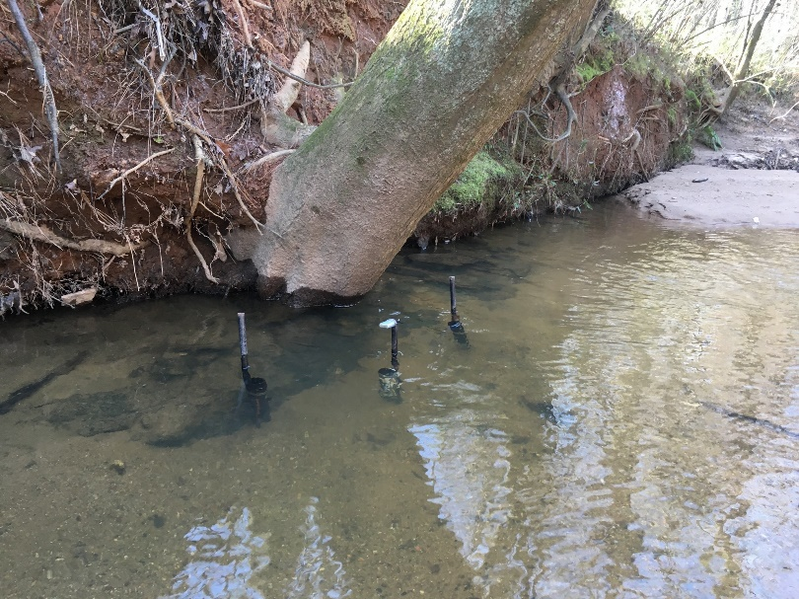
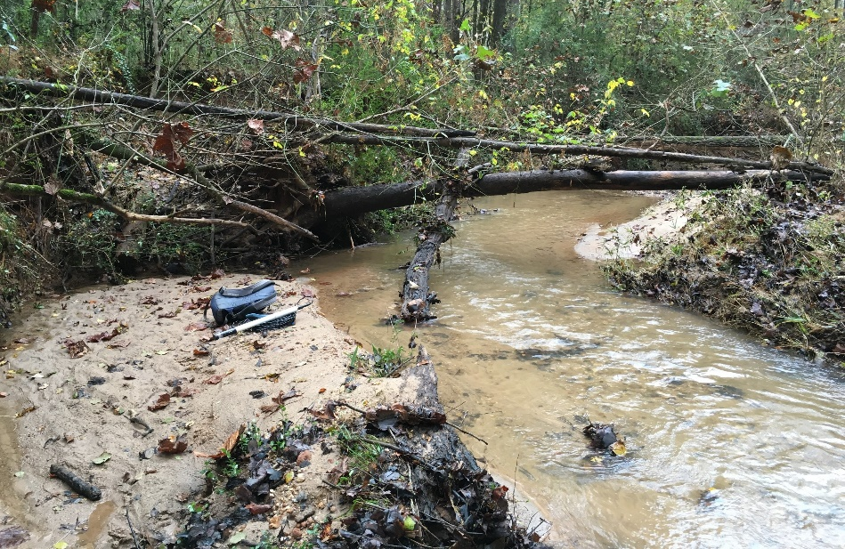
Research project overview
What’s already been done:
  Macroinvertebrate sampling
  Conductivity monitoring
  Water chemistry measurements
  Land use characterization
What we are doing right now:
  Macroinvertebrate identification
  Continued conductivity monitoring

Slide 7
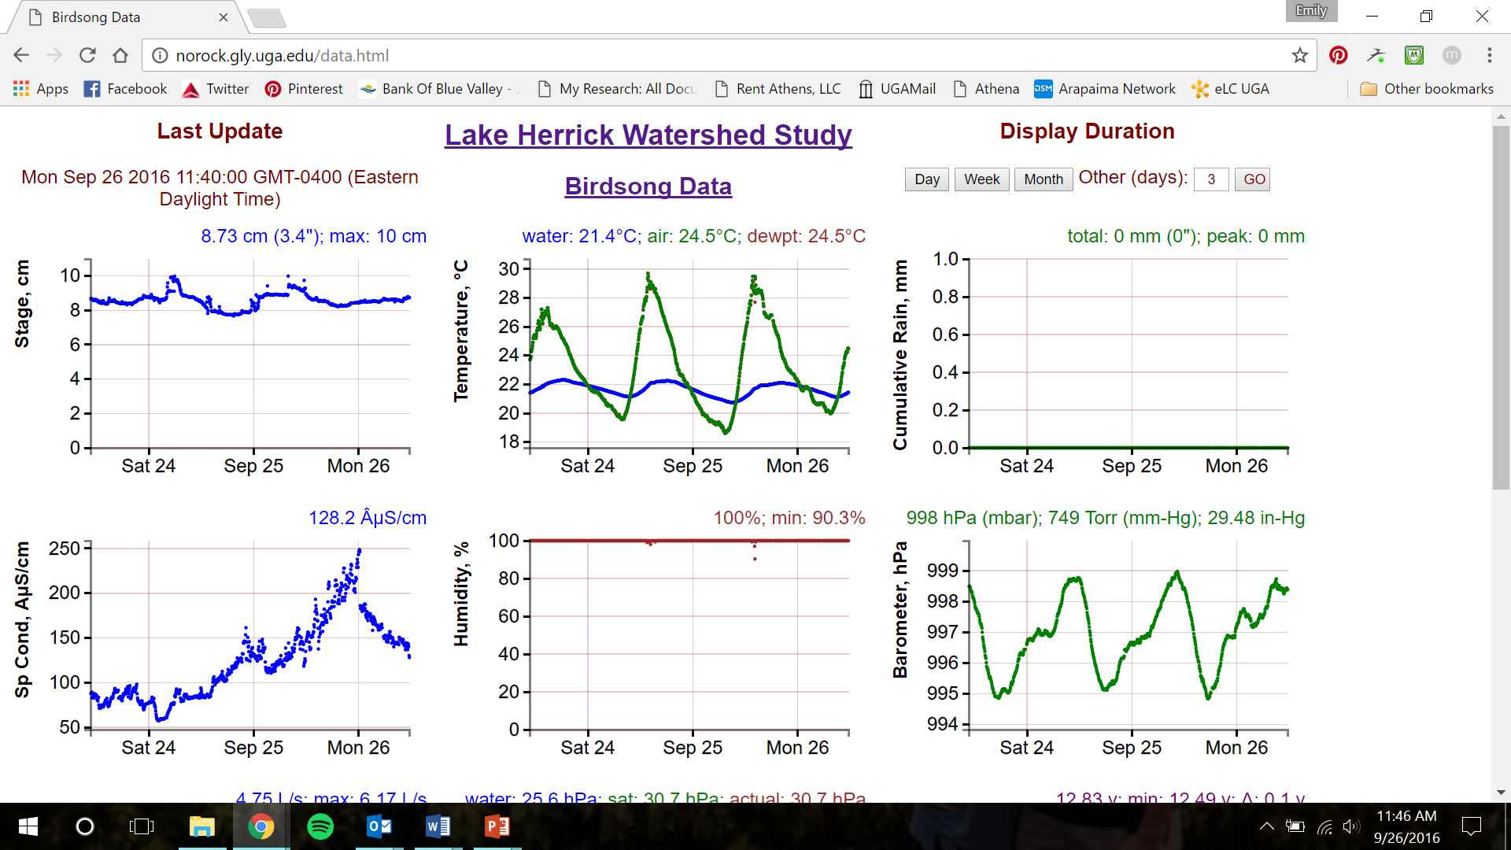
What’s Next?
Investigating continuous conductivity data for real-time, remote access monitoring tool
Evaluating alternative biomonitoring protocols
  Cost-benefit of differing approaches
Lake Herrick Watershed Study real-time data

Slide 8

Thank you!
Spencer family
UGA and Odum School of Ecology
River Basin Center

