Slide 1
Hydrogen Peroxide Signaling Controls Fecal Indicator Bacteria Fluctuations
Adelumola Oladeinde, Erin Lipp, Kyler Herrington, Brad Acrey and Marirosa Molina

Slide 2
Hydrogen Peroxide (H-O-O-H)
Omnipresent in surface waters
Produced via various pathways
Concentration varies by water body
Long half-life
High concentrations are toxic to bacteria
H-O-O-H production
Biotic processes
Abiotic processes
Dark
production
Aerobic metabolism
Glycerol metabolism
DOM exposure to sunlight
Light
production

Slide 3
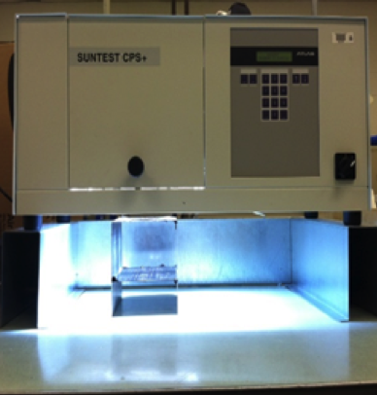
HOOH photo-production
Source of DOM
Mid-log Phase culture of E. coli & E. faecalis
HOOH
O₂-
O₂-
HOOH
¹O₂
OH.
HOOH
Filter Sterilized Water
Light Source
Hydrogen Peroxide Production
Bacteria Response & Interaction

Slide 4
Removal of photo-produced HOOH by E. coli
HOOH removal
Iron/sulfur
replenishment

Slide 5
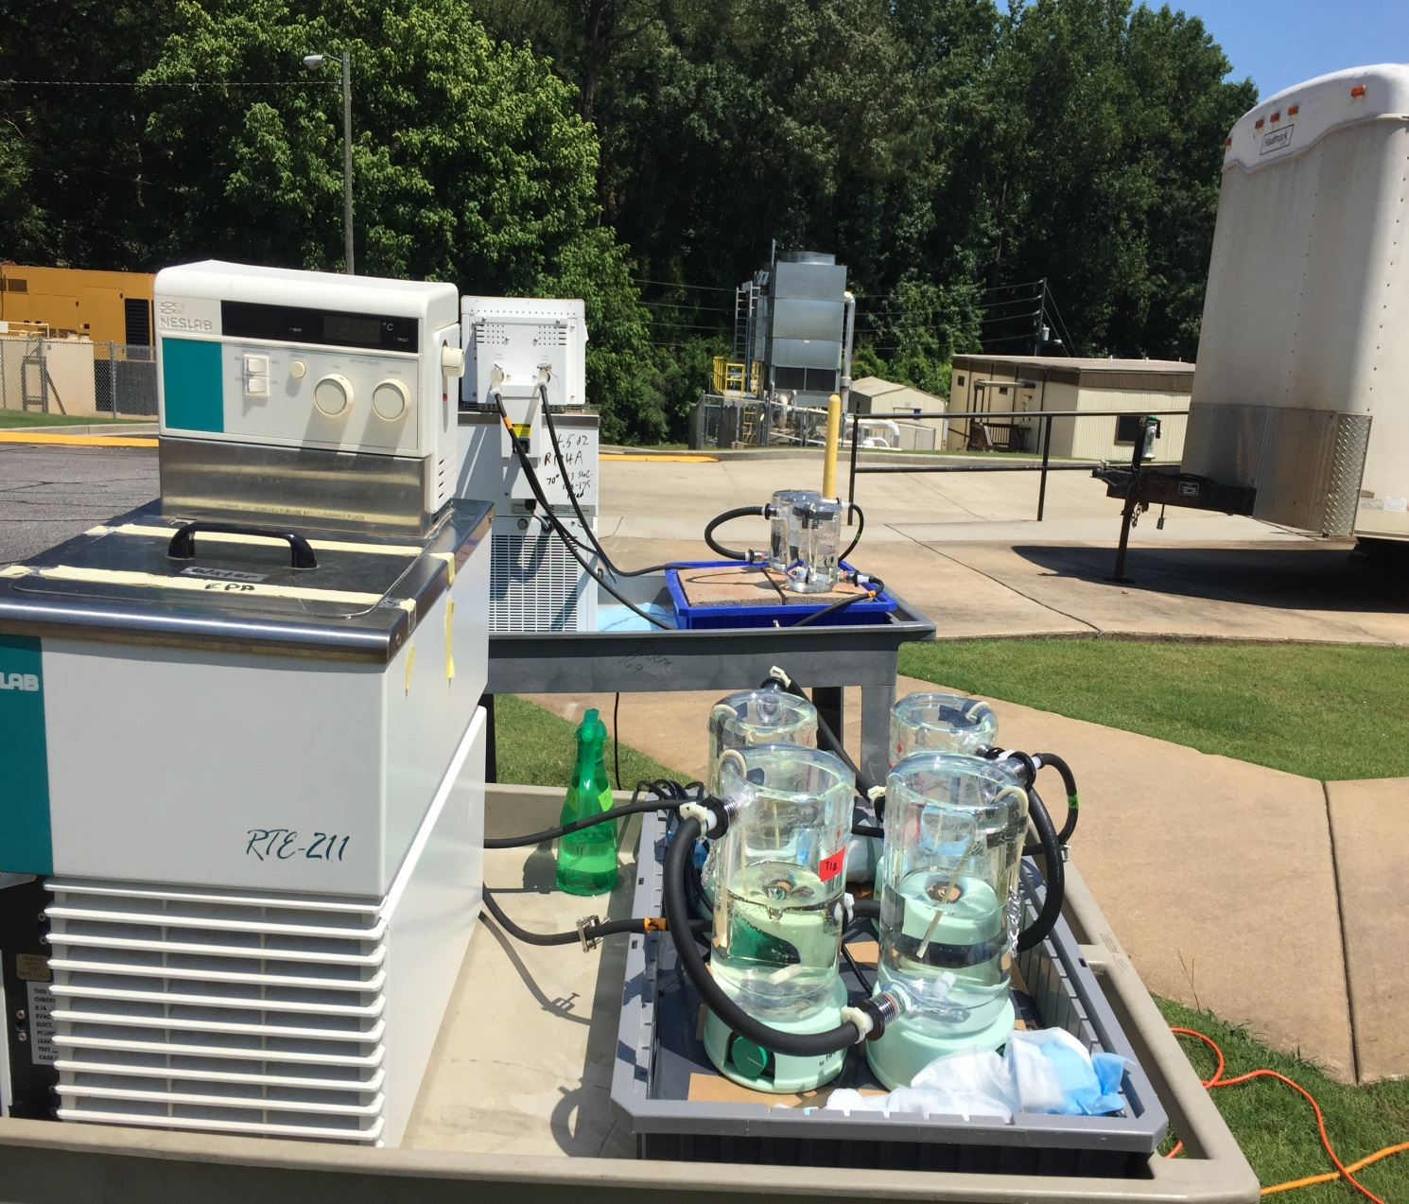
Outdoor Mesocosm Study
Fecal indicator bacteria added
Dark
Light
Dark
Light
Dark
HOOH photo-production
Water chiller
Stream water + DOM
Stream water only
-4h
0h
24h
28h
48h
52h
72h

Slide 6
E. coli has a higher regrowth potential
Bacteria added
Dark only
Light and dark cycles

Slide 7
Conclusion
Overnight HOOH removal is important for FIB to regrow.
E. coli has a higher regrowth potential than E. faecalis.
FIB should not grow in the environment.

