Slide 1
Bacterial community assembly in the Upper Oconee Watershed
Morgan Teachey
Ottesen Lab
UGA Microbiology

Slide 2

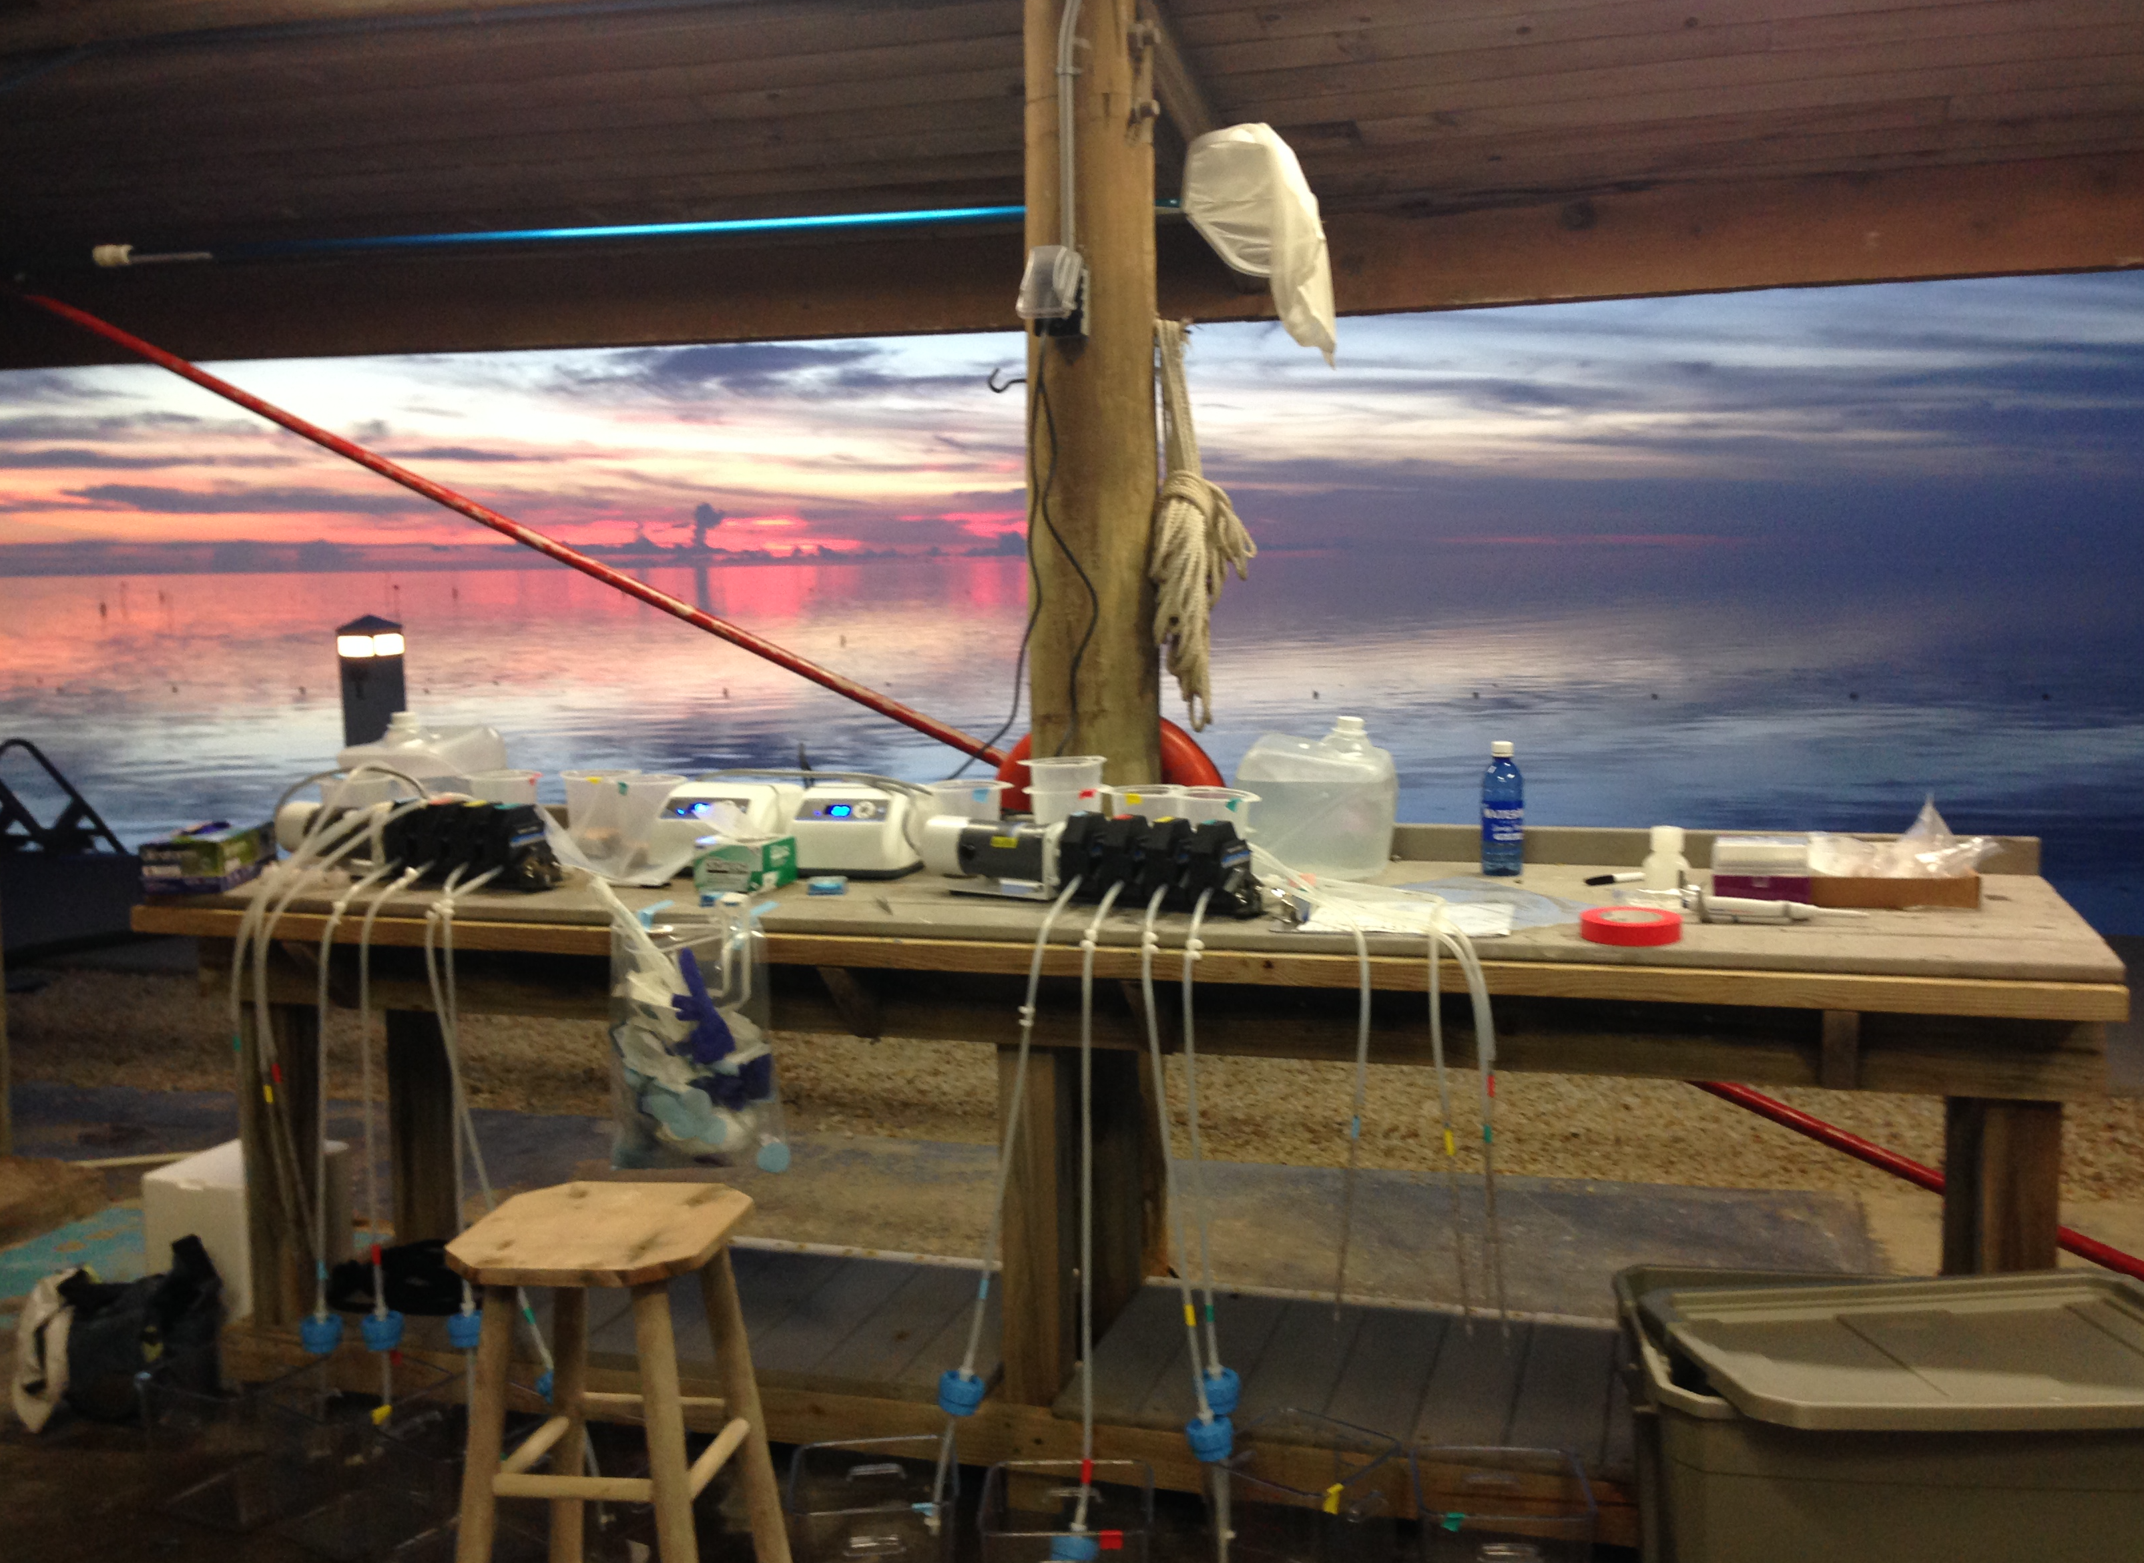
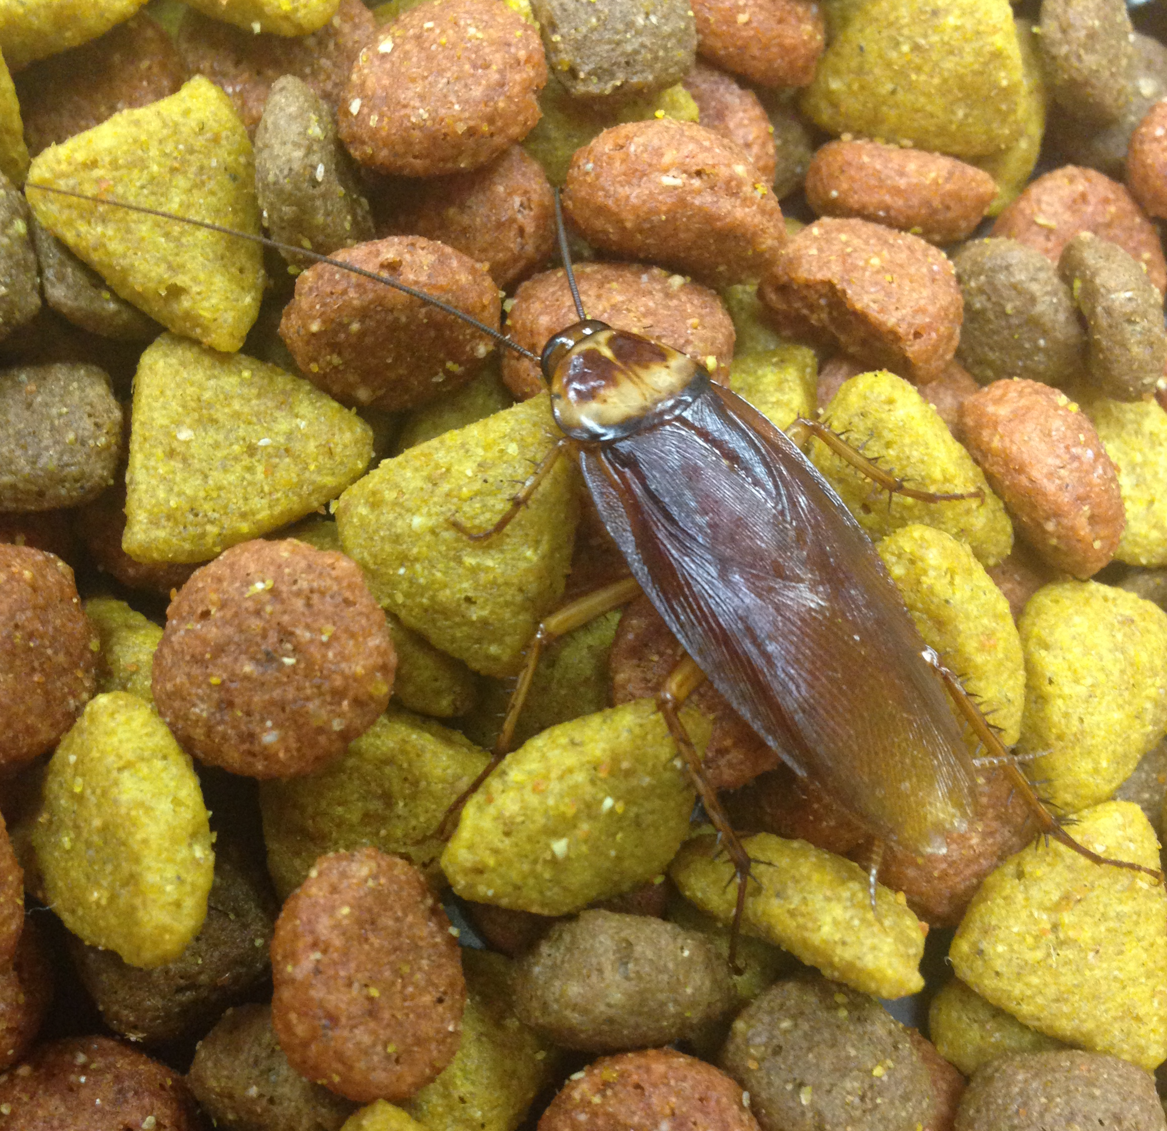
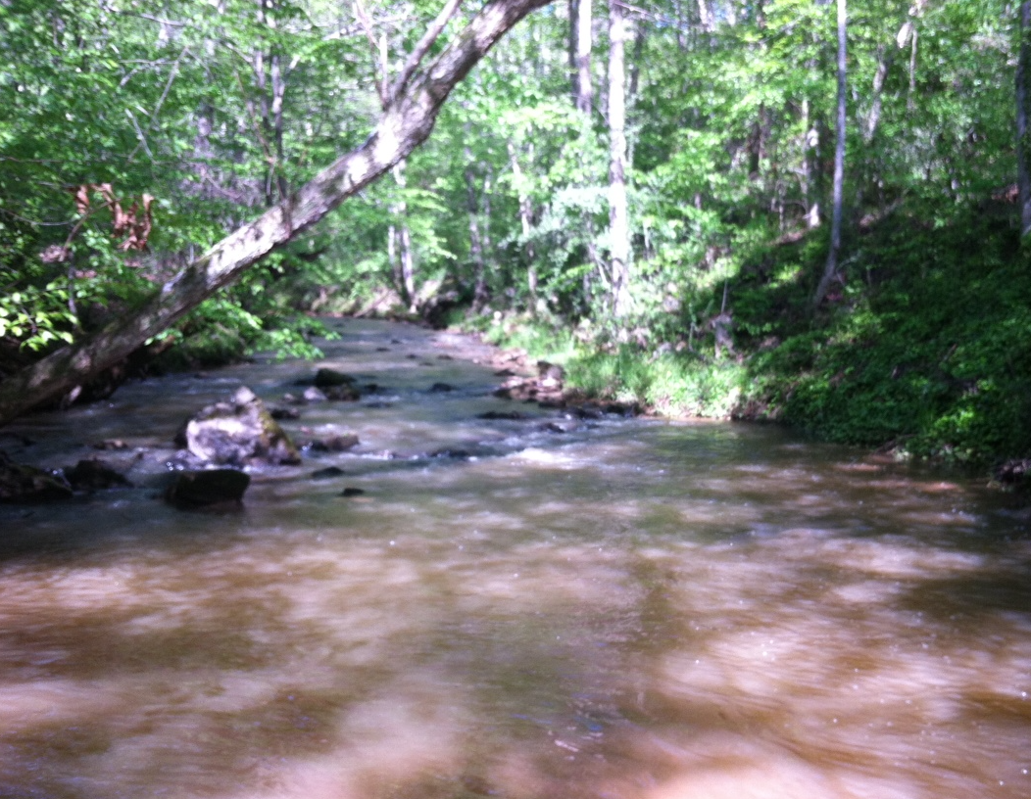
The Ottesen Lab
Microbial community assembly and succession
  Cockroach gut
  Atlantic ocean Vibrio populations
  Upper Oconee watershed
Notes:
Intro about me
Our lab studies microbial community assembly in succession in a variety of environments, including the cockroach gut, oceanic vibro populations and the Upper oconee wateshed
We combine fieldwork, molecular microbiology and bioinformatics to gain insight into how microbial populations change along the length of the river. Currently, we study seasonal variation in community structure paired with nutrient levels and are developing several projects involving McNutts creek

Slide 3

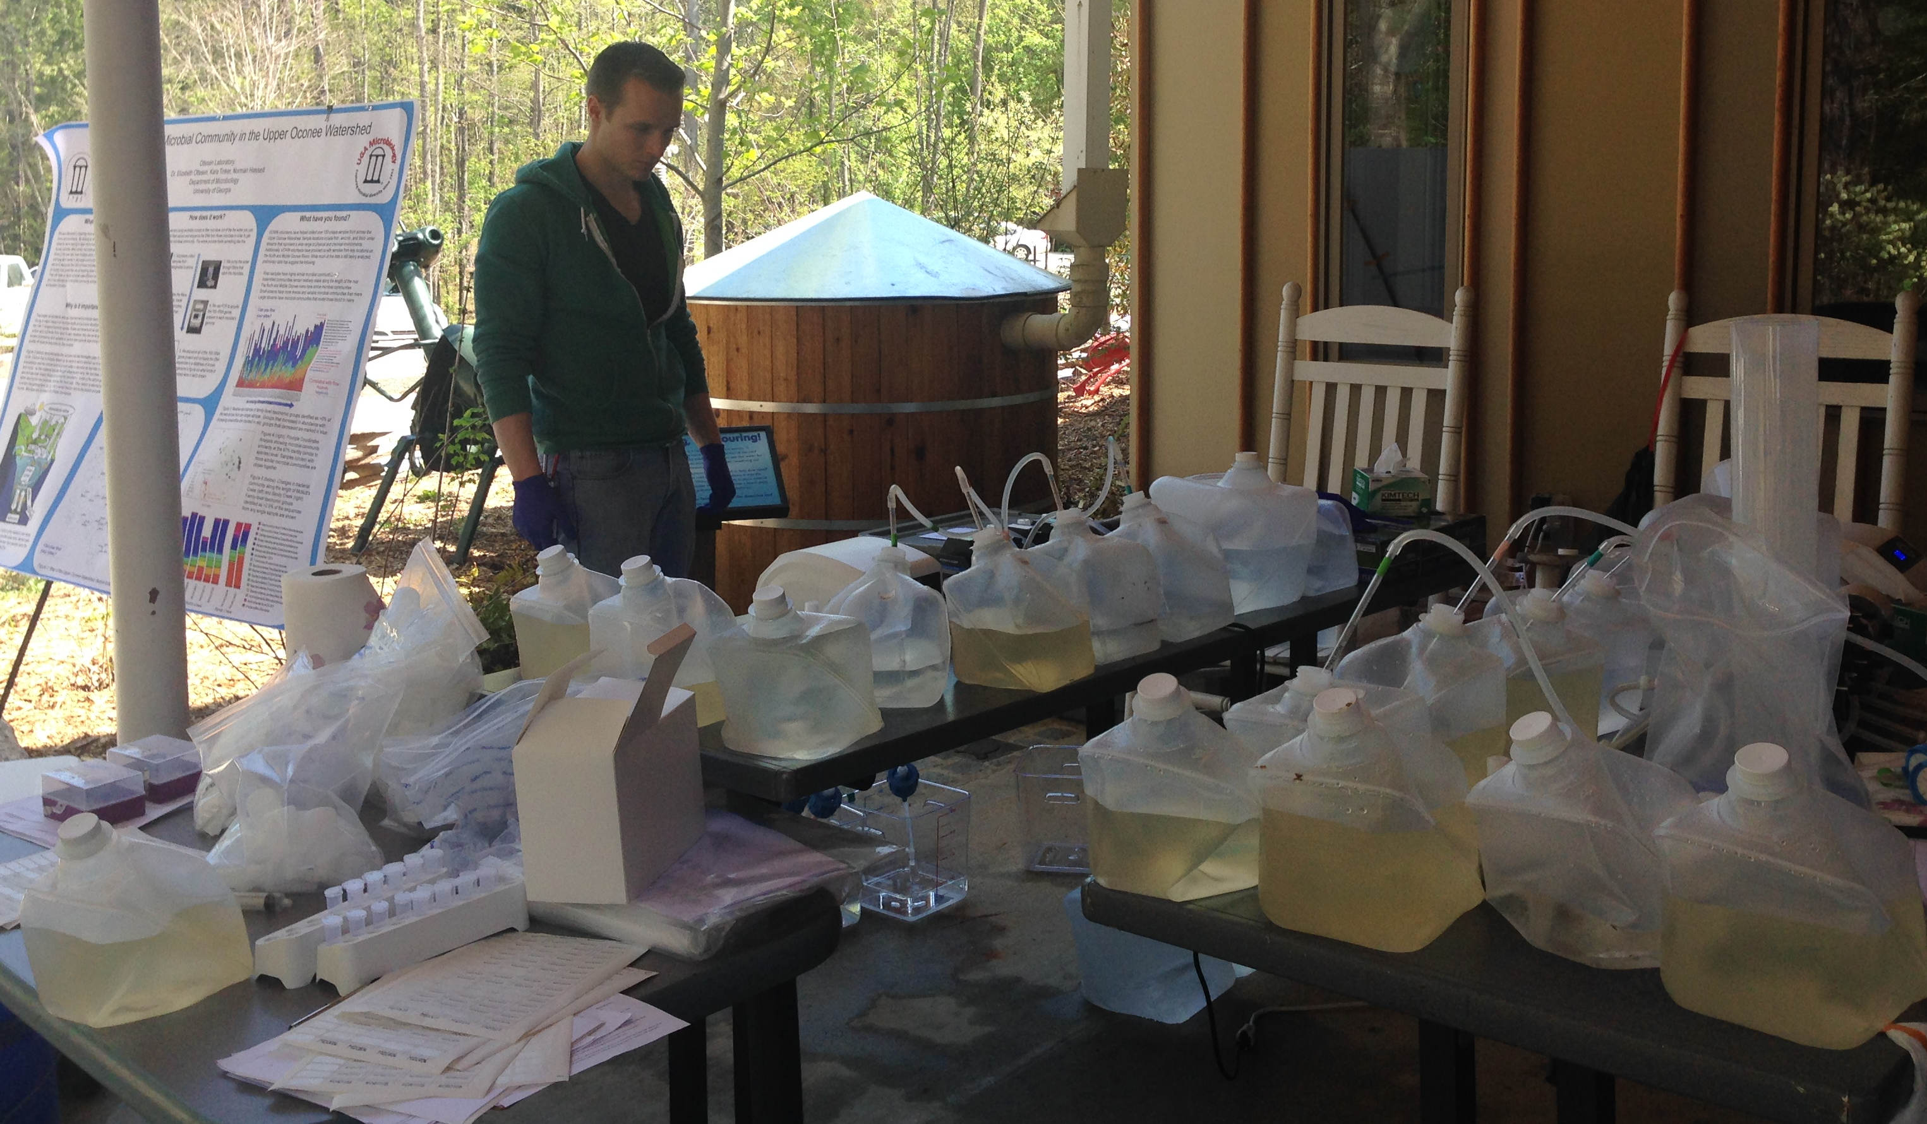
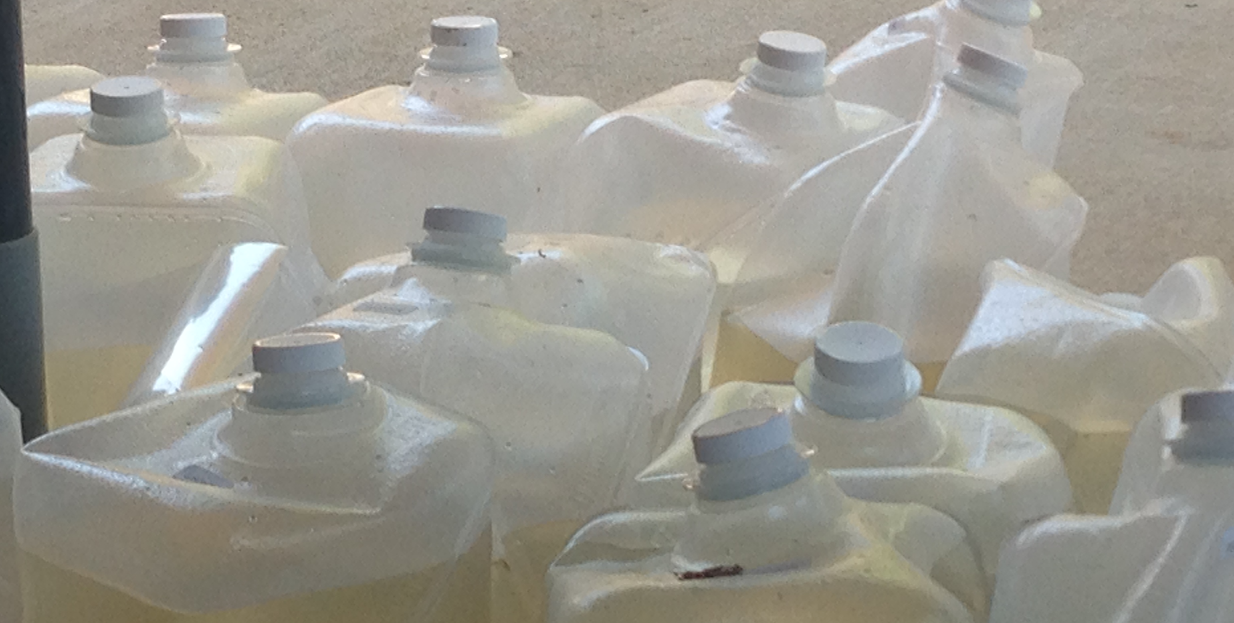
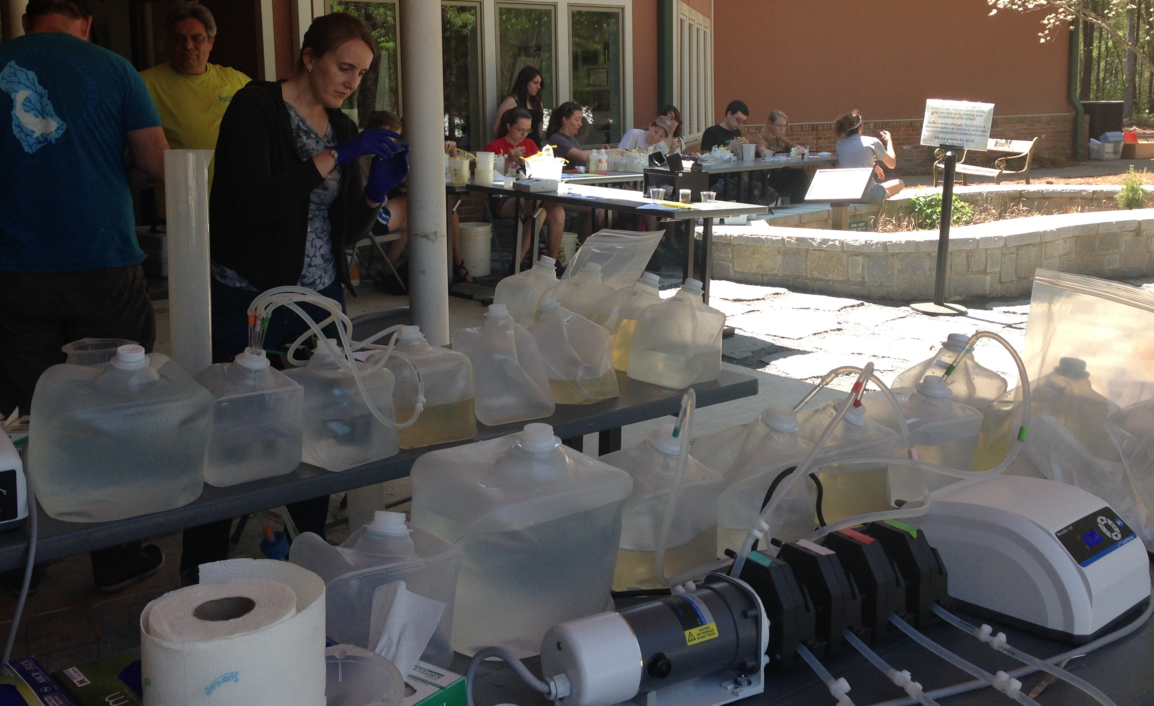
Ongoing projects: seasonal sampling
Focus on how the bacterial population in the water column is affected by:
  Season
  Physical, chemical, biological factors
  Interaction with surrounding environments
  Perturbations
Made possible by UOWN!
Notes:
Our work is focused on how the bacterial population of the water column is affected by season changes; physical, chemical and biological factors; interactions with surrounding environments and landscape-level perturbations. To do this we collect and filter water samples as you can see here.
Our group has participated in the quarterly sampling events held by UOWN since Summer (?) of 2013. Without this partnership, data collection to this scale would be much more difficult, so many thanks to UOWN for hosting this events and for all of their help with our work!
Before I get into some data, I like to mention Normal Hassel, who recently graduated with his Masters and is now at the CDC. Most of the work I’ll be presenting today is from his thesis and publication which is currently in prep.

Slide 4
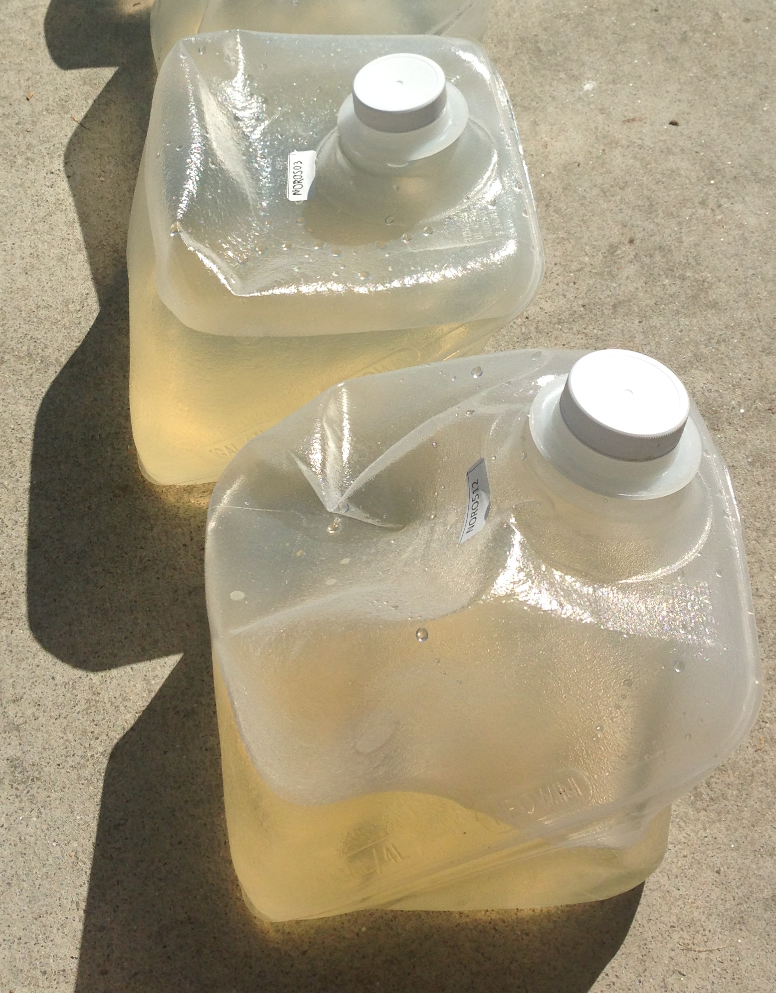
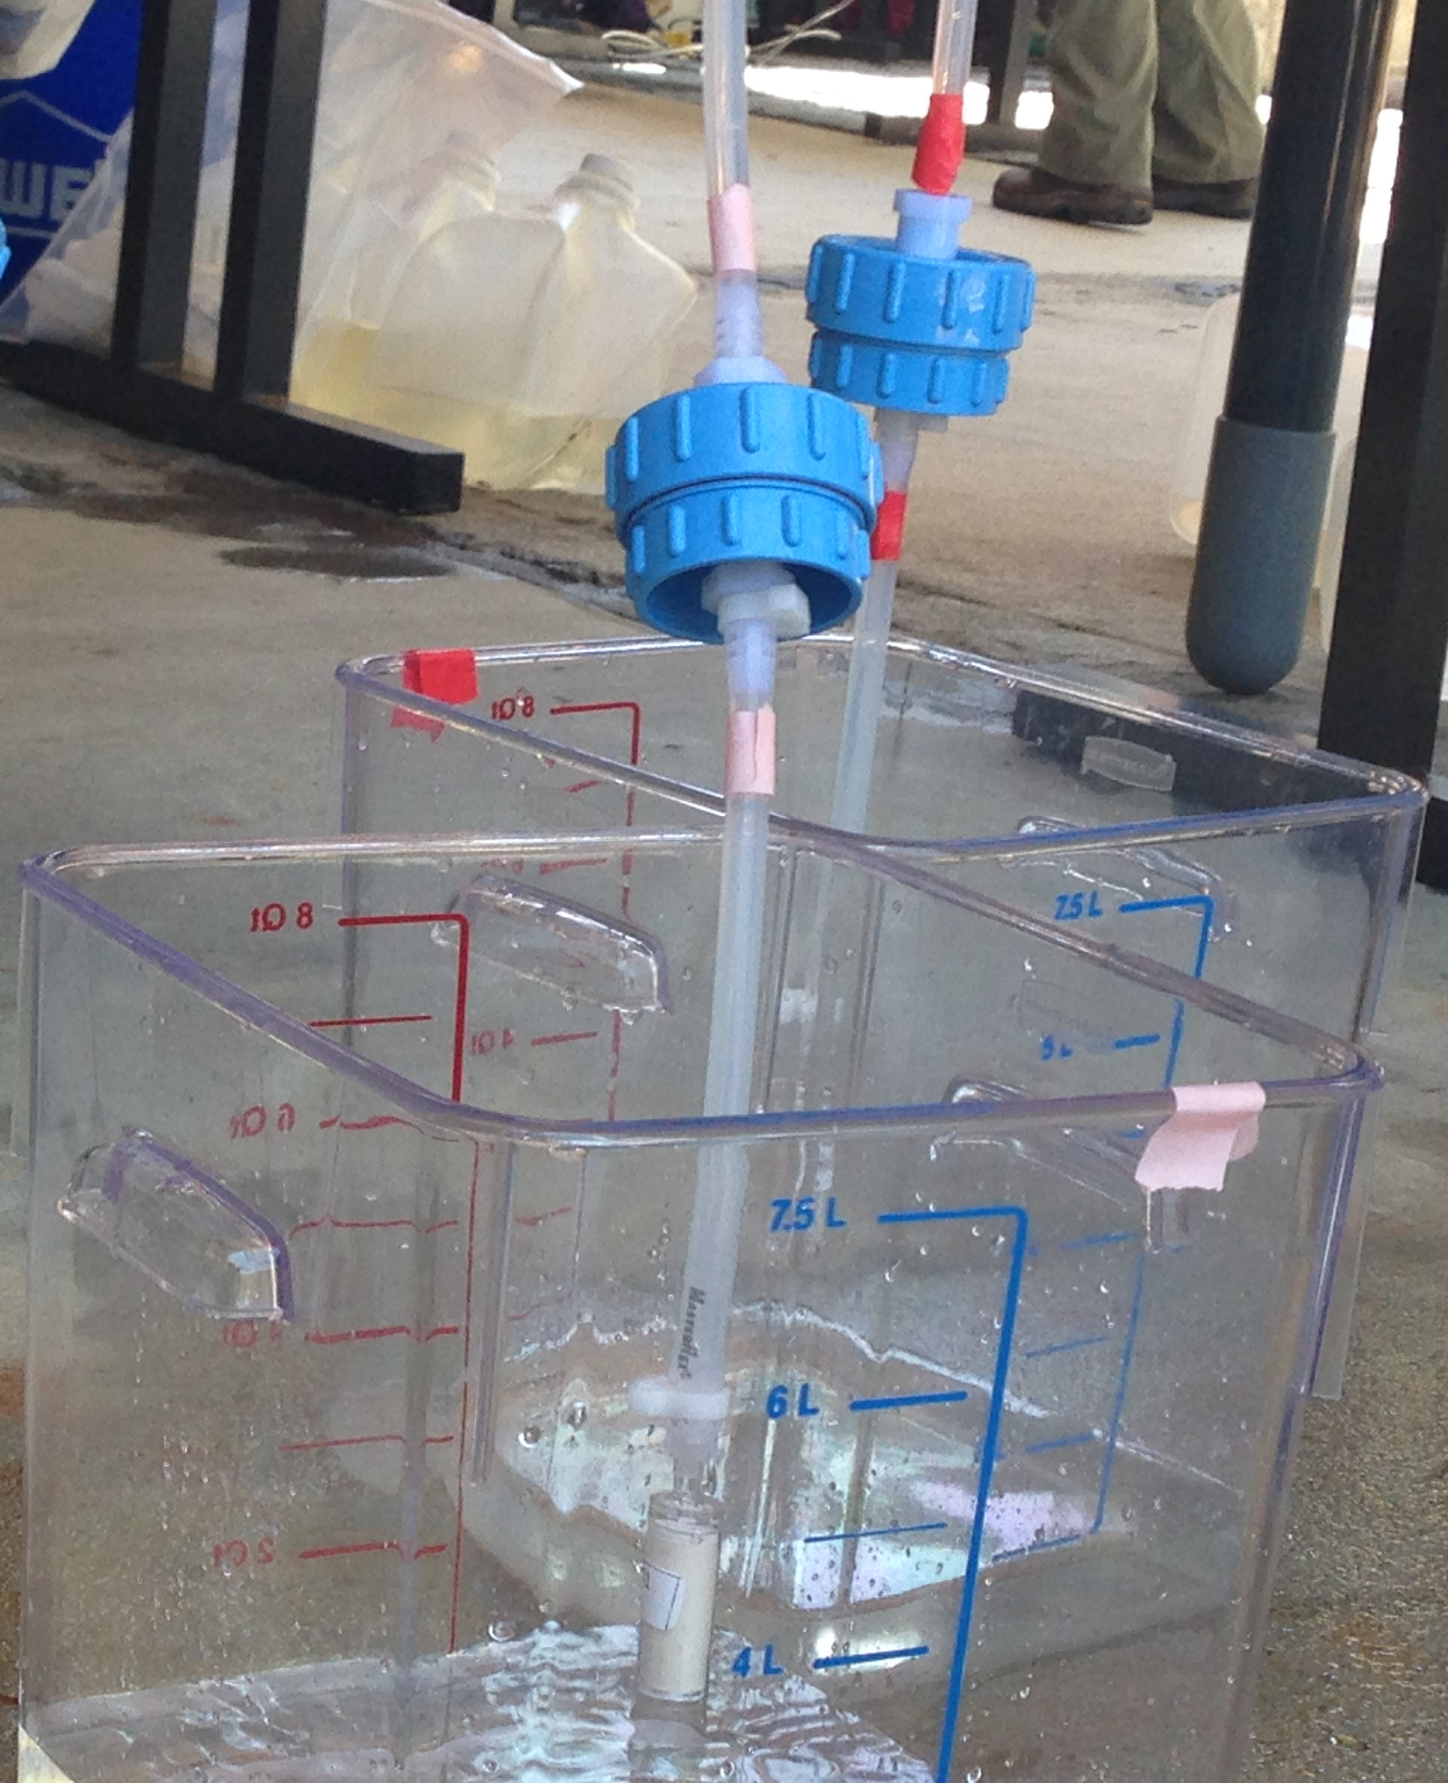

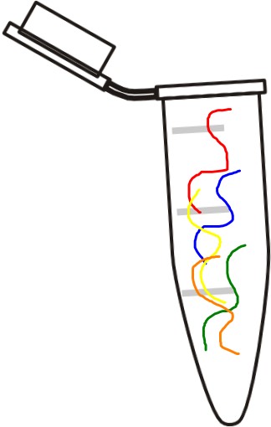
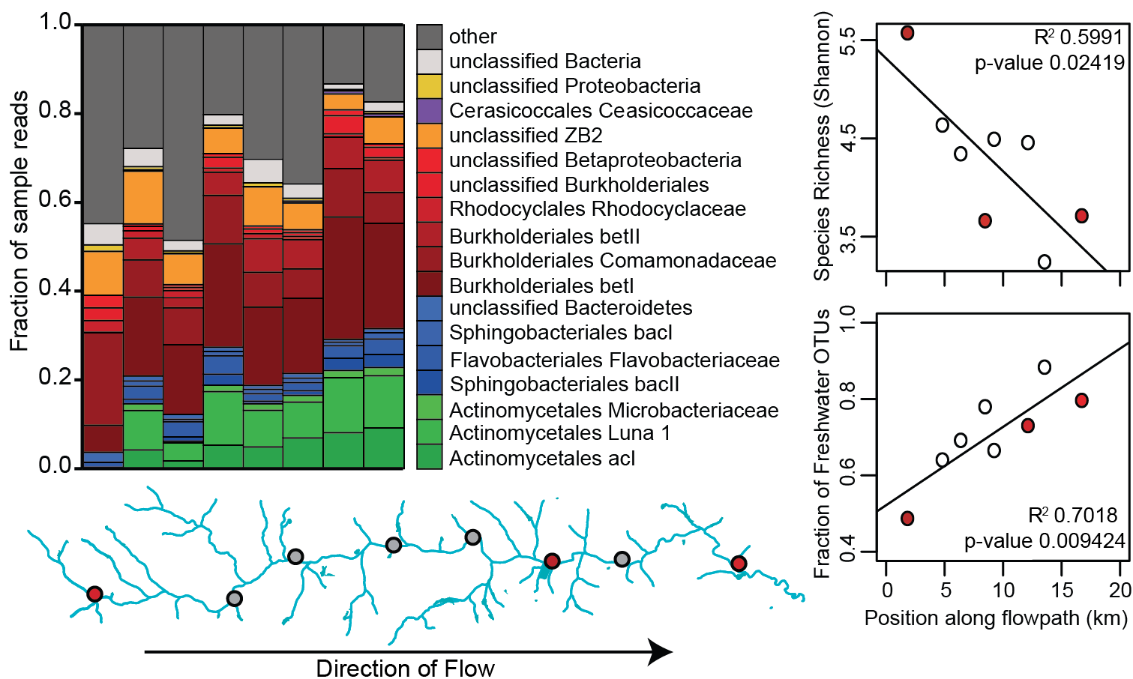
Methods
Collect water
Isolate DNA
Barcode DNA
Filter samples
Determine bacterial community
http://www.clker.com/cliparts/Y/b/R/h/j/h/eppendorf-tube-with-open-cap-hi.png
http://sweetclipart.com/multisite/sweetclipart/files/dna_black.png
Notes:
to briefly describe our methods, we collect water samples and filter out the bacterial fraction. from there, we isolate DNA, label each sample with a unique barcode and use high-throughput sequencing methods to determine the bacterial community of each site

Slide 5
Decrease in bacterial diversity and increase in core taxa along stream size gradient
Hassel, et al. 2016. Manuscript in preparation
Spring 2013
Notes:
I’d like to introduce our work by sharing the results of a yearlong study completed between spring of 2013 and 2014, spanning 5 seasons. Here, I’m showing the community composition at the family level of many sample sites across the watershed, with each bar representing a single sample. The height of the colored sections within each bar represents the relative abundance of that family in the sample. These samples are in order from left to right according to cumulative distance from the headwaters, which roughly correspond to stream size gradient, with smaller streams to left and larger streams and rivers on the right. As the distance of the sample from the headwaters increases, there’s a general trend of increasing diversity loss, coupled with an increase in relative abundance of certain families. The most prominent families in each sample are show in colors, while the remaining, less abundant bacteria are grouped into the “others” category. I’d like to draw your attention to 3 specific groups, the actinomycetes, bacteriodetes, and betaproteobacteria. these groups are commonly found in freshwater environments and make up a significant fraction of the microbial population throughout the watershed, but dominate at its lower reaches.

Slide 6
Decrease in bacterial diversity and increase in core taxa along stream size gradient
Microbial Richness
(Shannon)
Fraction of
freshwater species
Hassel, et al. 2016. Manuscript in preparation
Spring 2013
Notes:
To look at the data in a different way we plotted each site is plotted according to its distance from the headwaters and the level of richness in community on the left. This reflects the extent of taxonomic diversity in each sample, and we observed a steady decrease as the stream size gradient increases. This verifies the trend observed in the relative abundance data shown on the bar plot
We also looked at how the presence of commonly found freshwater species changed throughout the watershed. These species were present in 90% or greater of all samples within all sampling seasons. We tracked their fractional abundance, and observed an increase in abundance as stream size increased. This aligns with the results of other group’s studies and suggests that streams act as filters, rather than pipes, of bacterial communities. In other words, these data suggest that streams apply selective pressures on bacterial populations, reducing the relative prevalence of some groups and increasing the abundance of others.

Slide 7
Different seasons, different patterns
Microbial Richness
(Shannon)
Fraction of
freshwater species
Hassel, et al. 2016. Manuscript in preparation
Notes:
So far I’ve focused on a single season, spring 2013, but we wanted to look at seasonal changes throughout the study.
We looked at species richness and the fractional abundance of freshwater-associated bacteria for each season. there is a loss of species richness in both springs and the fall as distance from headwaters increases. For summer and winter there is little chance in richness between sites, which was expected given the results of the family abundance data.
In terms of freshwater-associated bacteria, their fractional abundance rose in 3 or 5 seasons, and remained relatively unchanged in the summer and winter. These data imply that there may be additional factors influencing the hypothesized selection gradient occurring in the watershed. interestingly, a large rainfall event occurred right before this summer sampling event, and the temperature before and during the winter sampling was much lower than during the other sampling events. While we currently draw conclusions based on this information, it sets the stage for follow up studies to be completed in the future
Freshwater microbial populations are variable and not well defined, however we wanted to see if freshwater-associated microbes were selected for as they traversed the watershed. To do this used a database of freshwater lake bacterial sequences generated by the MacMahon lab at Wisconsin Madison to serve as a for fresh-water associatednOTUs. ,

Slide 8
Different seasons, different patterns
Microbial Richness
(Shannon)
Freshwater associated
Fractional abundance
Fraction of
freshwater species
Hassel, et al. 2016. Manuscript in preparation
Notes:
we observed a loss of species richness coupled with an increase in the fractional abundance of freshwater-associated bacteria in both springs and the fall as distance from headwaters increase. This pattern of increased abundance of freshwater microbes as stream size increases has been reported by other groups as well. What’s interesting though, is that we only observed this trend in 3 of the 5 seasons.

Slide 9
Different seasons, different patterns
Microbial Richness
(Shannon)
Freshwater associated
Fractional abundance
Fraction of
freshwater species
Hassel, et al. 2016. Manuscript in preparation
Notes:
For summer and winter there is little change in richness between sites, and freshwater bacteria fractional remained relatively constant.
To make sure that this wasn’t due to the low number of samples collected, we selected and analyzed the spring and fall data from the same sites sampled during the summer and winter collection. We found that the observed trends in decreasing richness and freshwater species abundance to be maintained.
These data imply that there may be additional factors influencing the hypothesized selection gradient occurring in the watershed. For example, a large rainfall event occurred right before this summer sampling, which could have diluted the normal microbes in streams and therefore disrupted assembly patterns.
Also, the temperature before and during the winter sampling was much lower than during the other sampling events, which may have affected growth rates and therefore community assembly patterns in this data.
While we can’t currently draw conclusions based on this information, it provides a driver for our continued work with the river system and sets the stage for follow up studies to be completed in the future

Slide 10
Focusing in on McNutts Creek
Fraction of Freshwater species
Spring 2014?
Notes:
For example, we’ve recently expanded out work to include high resolution studies on McNutts creek. By focusing on a single creek we can get a more detailed picture on microbial population change from site to site and even on a day-to-day basis. We chose McNutts as a model because its relative abundance and richness datasets mimic that of the whole watershed. Also it is relatively unperturbed by large tributaries until it meets with Barber, giving us 18km of an isolated study system to work.
The sites highlighted in red are 3 focus sites we chose for daily monitoring in a pilot study we completed this summer
Water sample collection from 3 focus sites for 11 days
Soil and sediment samples collected at midpoint of study
Preliminary data to be gained:
Daily fluctuations in microbial populations
Effects of multiple storm events captured during study
Comparison to neighboring environment’s populations

Slide 11
Future studies
Continue seasonal study of whole watershed for long-term results
Single-day high-resolution study of McNutts for quantitative results
Metagenomic and metatranscriptomic studies to determine population functions
Landscape-level perturbation studies
Notes:
in the future, we’ll be continuing our ongoing seasonal study of the whole water for long-term results. we plan on incorporating quantitative abundance studies as well as metagenomic and metatranscriptomic work to better understand how these populations are functioning at different locations.
I’m excited to continue to share our work with all of you and hope that it will be useful in developing policies and procedures for our watershed in the future

